Slide 1
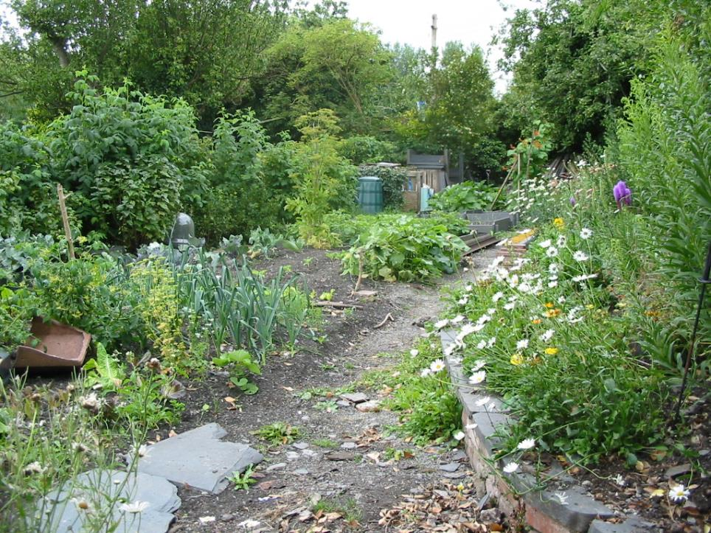
THE LIFESTYLE LAB
A case study in eco-retrofit

Slide 2
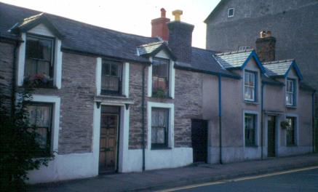
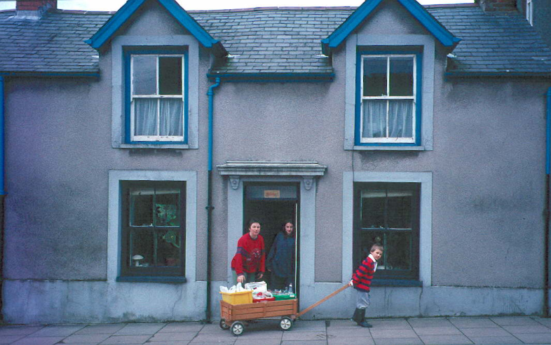

Slide 3
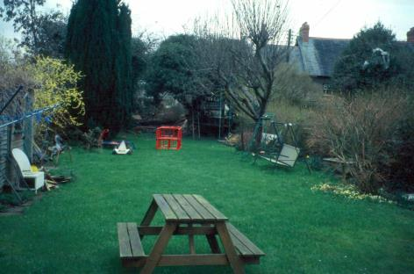
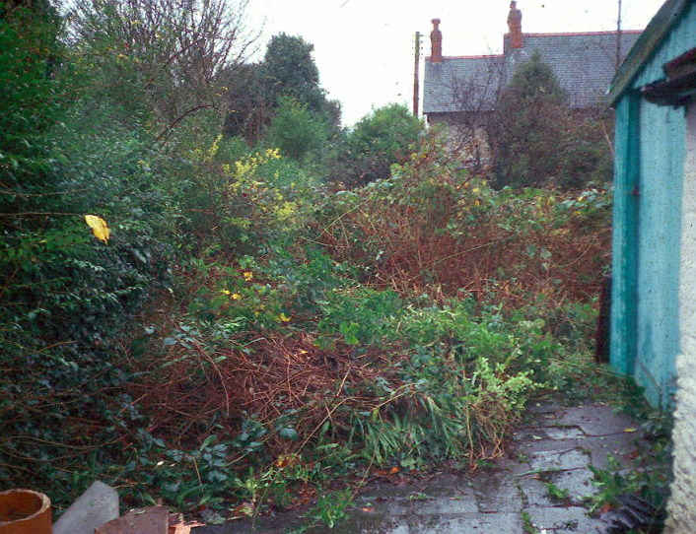

Slide 4
BASIC PRINCIPLES
The household should make the maximum practical contribution to ‘sustainability’
At this stage in the process, generalisable results are the most useful output, rather than simply ‘being green’ (or anything that amplifies)
It should be designed with results in mind
BUT there should be a reasonable balance between research and ‘just living’
One or more areas of specialisation should be chosen

Slide 5
ACCELERATED MAINSTREAMING
Take-up %
How can we accelerate shift into the mainstreaming phase?
You are here

Slide 6
FINDING THE BALANCES
Modest conventional standards of comfort and appearance
Multiple systems where appropriate, straddling the threshold of conventional standards
No perfectionism
Quit while you’re ahead
A sprat to catch a mackerel is OK
BATNEEC: do the best you can within the budget

Slide 7
PERSONAL CHOICES
House and garden considered as a single unit
All-purpose garden: test-bed, demonstration, recreation, wildlife, waste-processing, edible crops
Share/specialise with adjacent garden
Child friendly (negative and positive)
Respect the history and genius loci of the site

Slide 8
One final rule to sharpen the results in the chosen specialism (and to make the conversion phase more interesting):
No skips, no bonfires

Slide 9
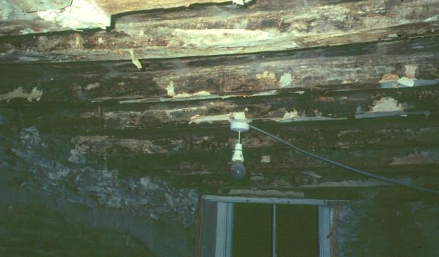
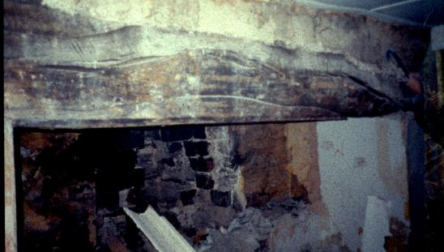
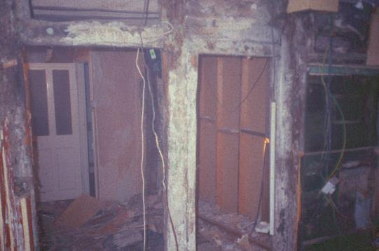

Slide 10
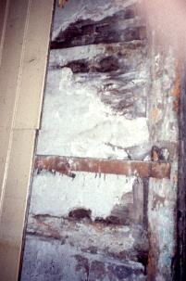
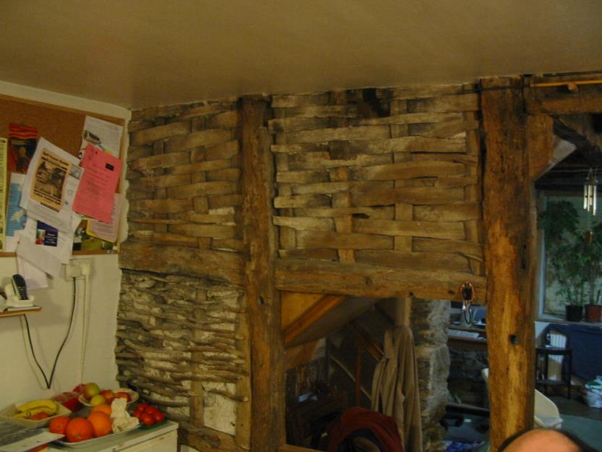

Slide 11
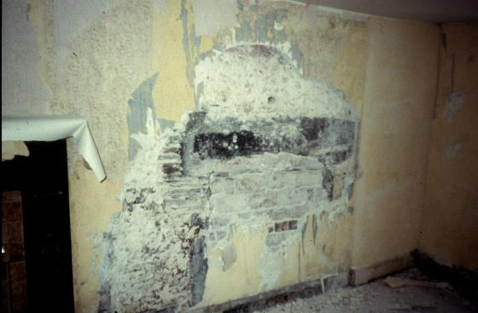
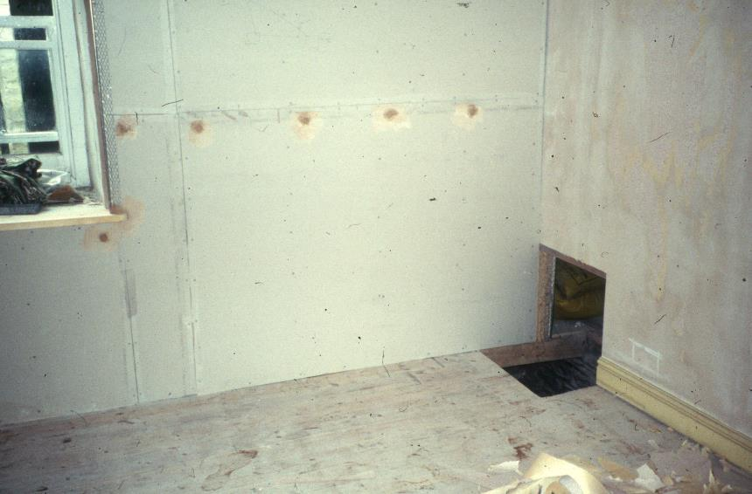
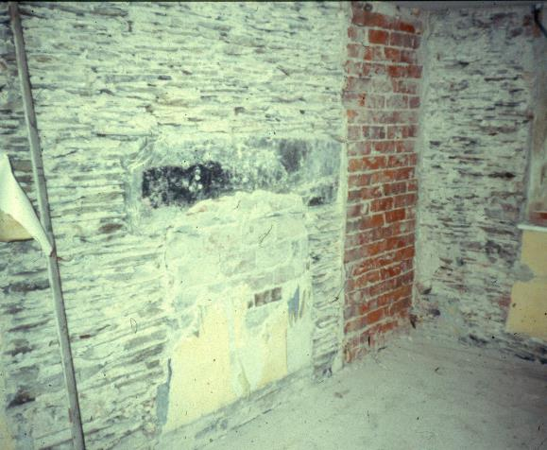
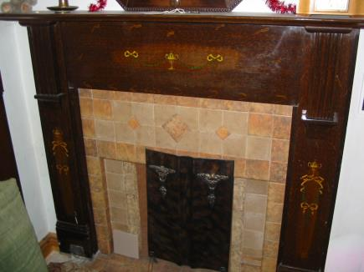

Slide 12
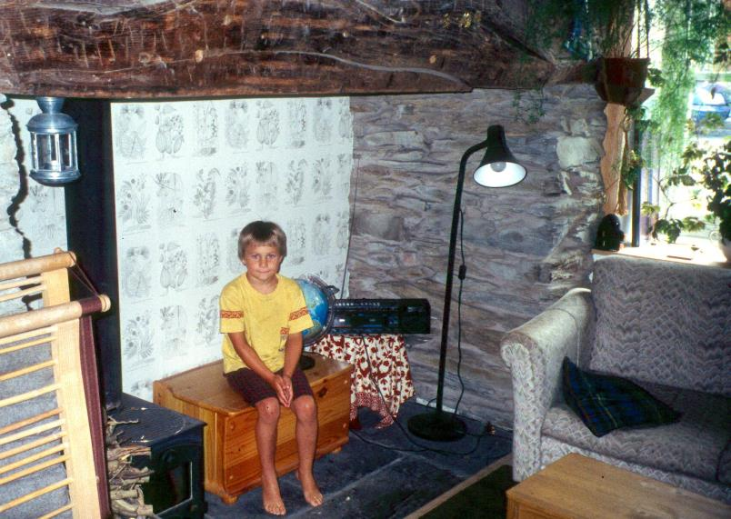

Slide 13
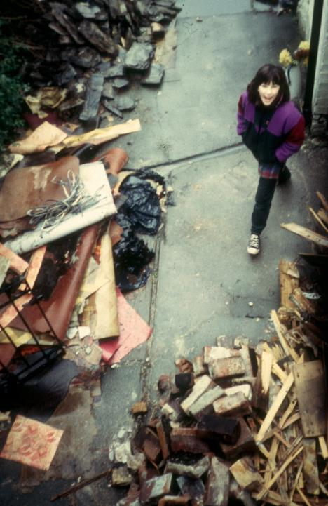
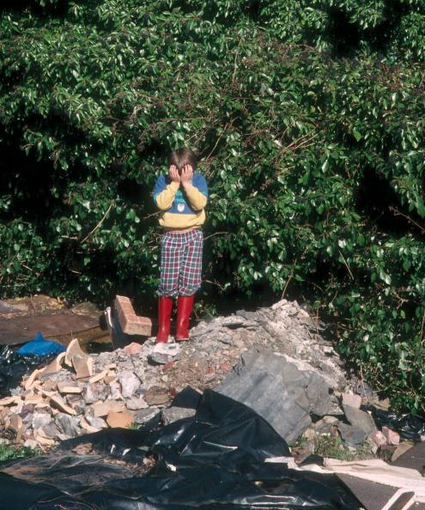

Slide 14
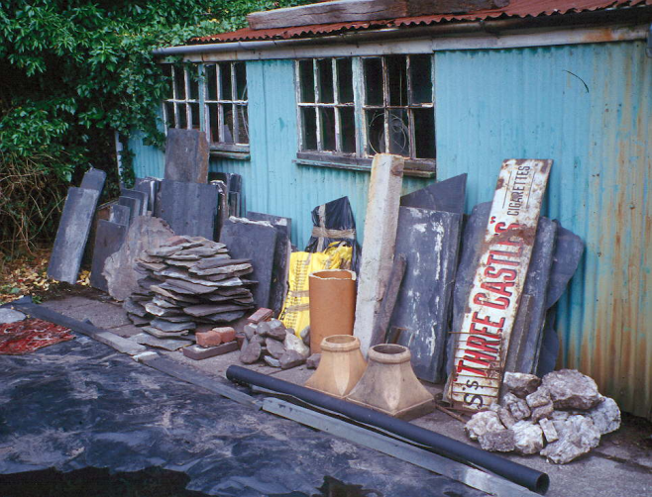
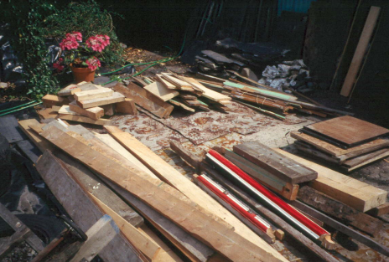

Slide 16
Amenity zone
Productive zone
Utility zone

Slide 17
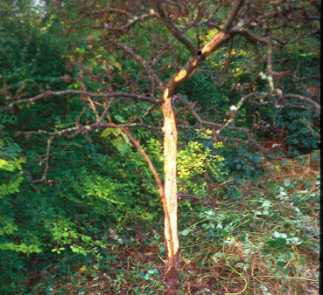
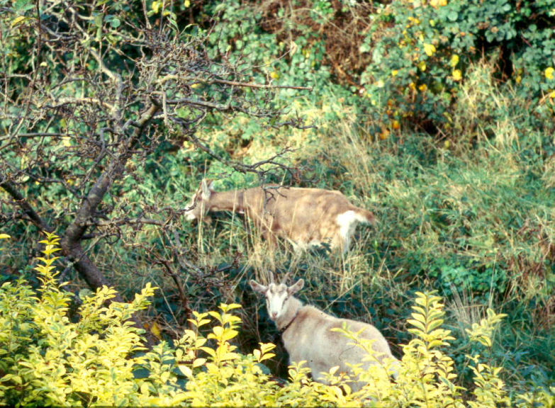

Slide 18
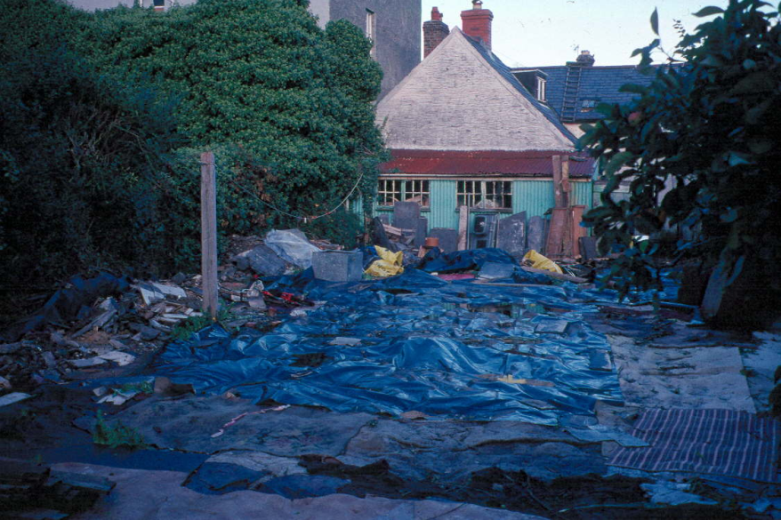
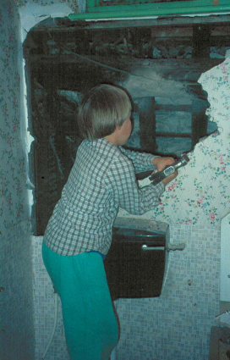

Slide 19
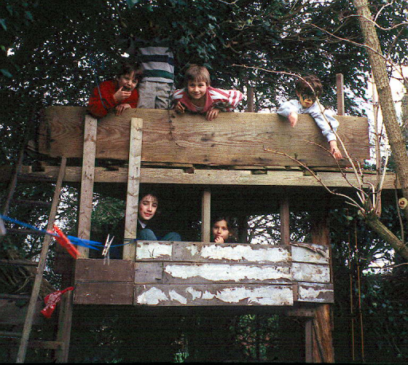
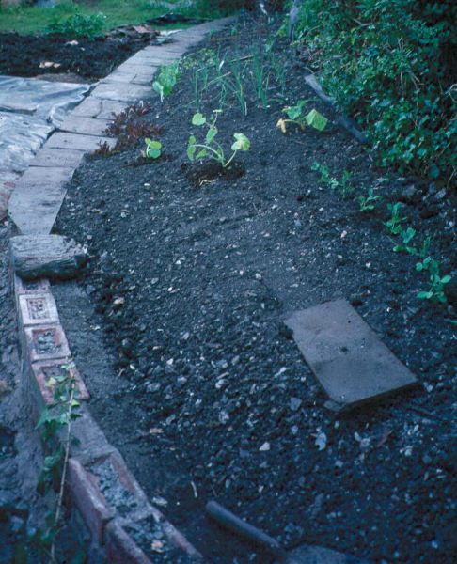
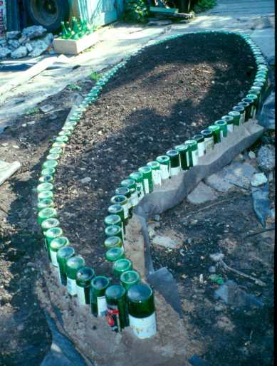

Slide 20
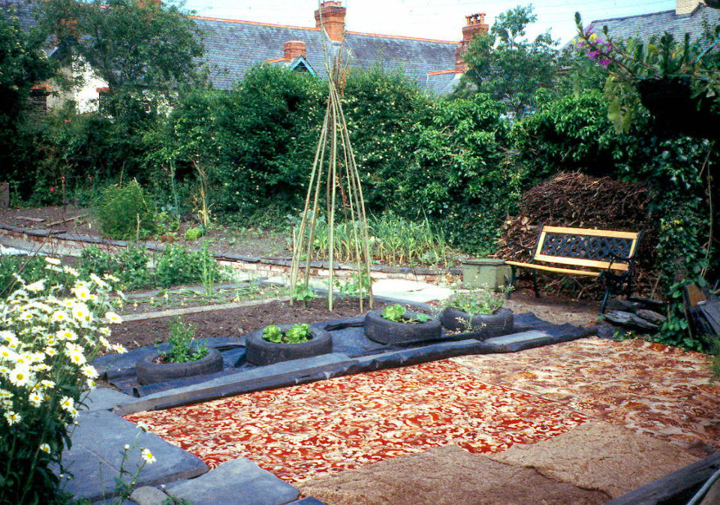

Slide 21
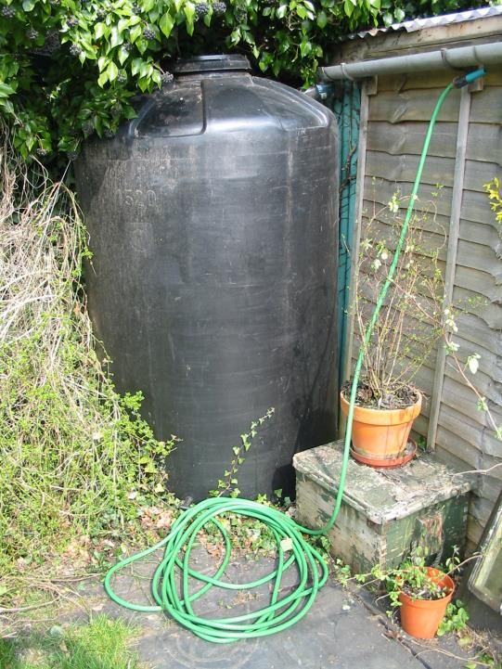

Slide 22
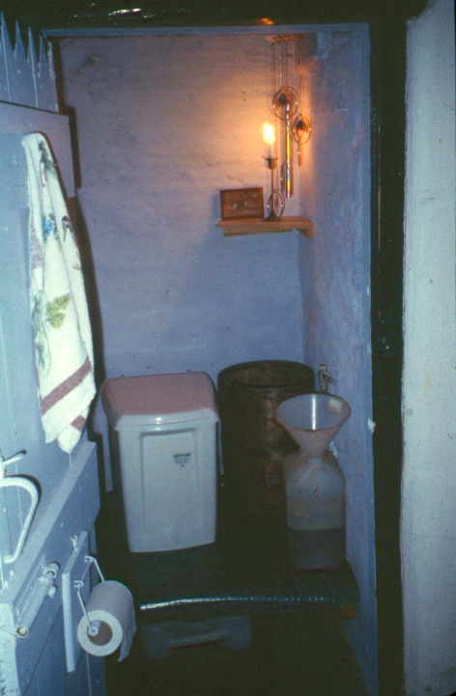
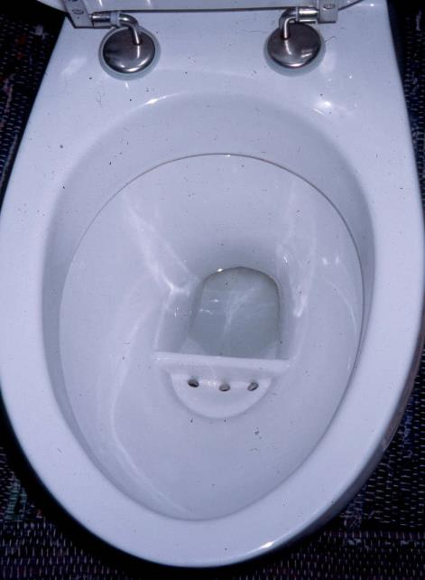

Slide 23
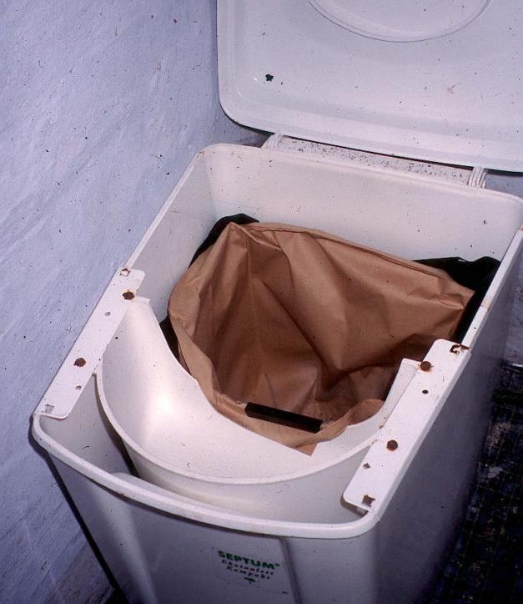
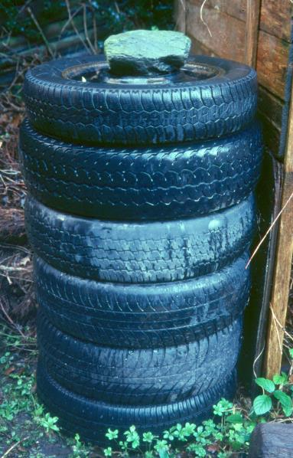

Slide 24
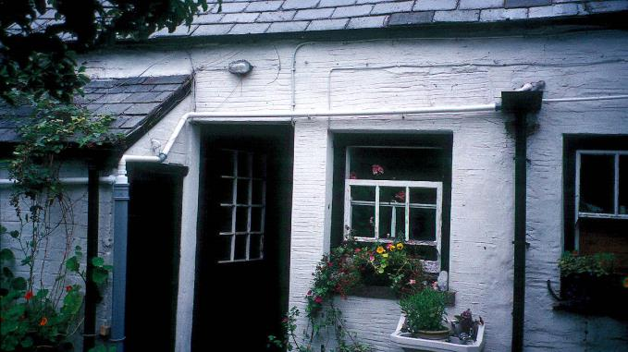
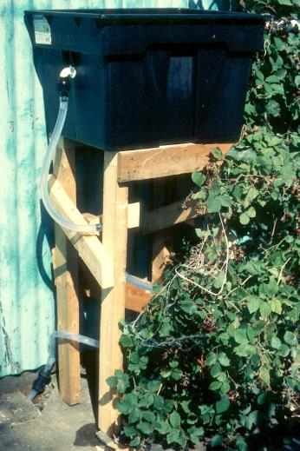
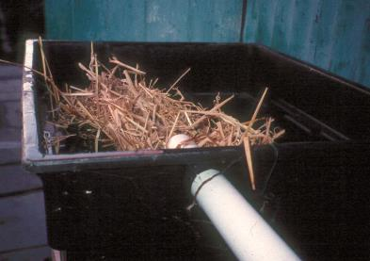

Slide 25
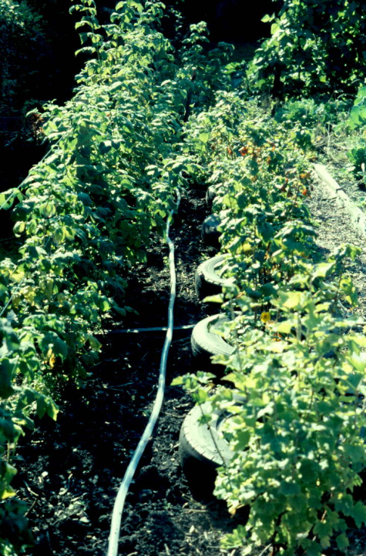
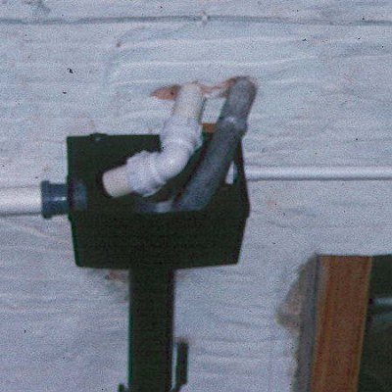
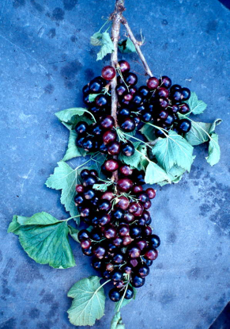

Slide 26
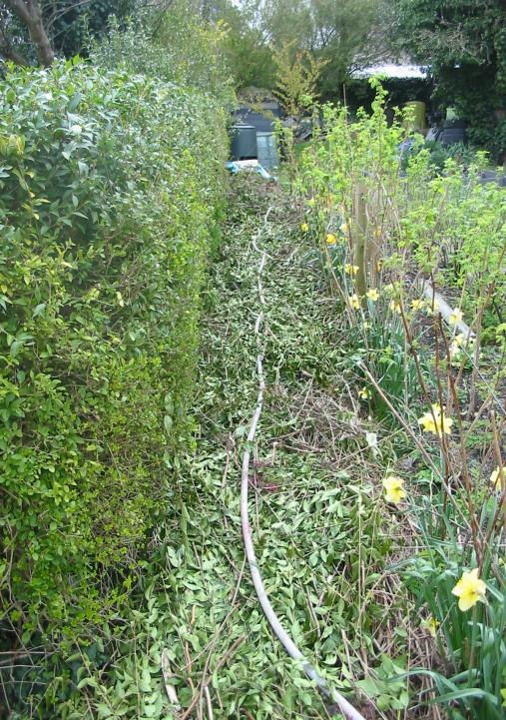
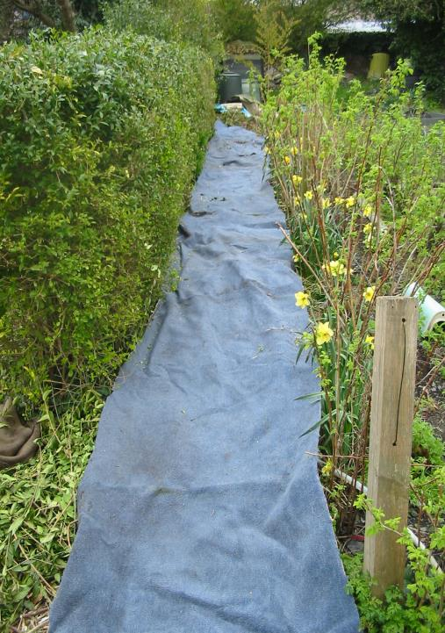

Slide 27
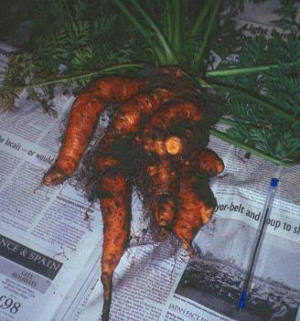
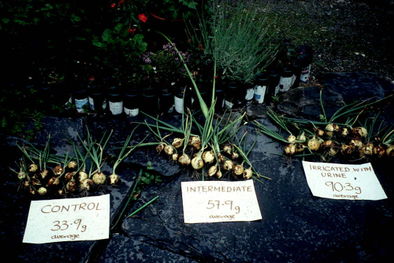
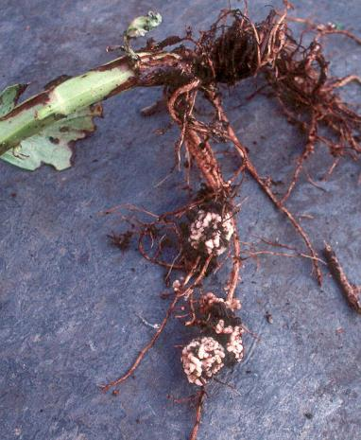
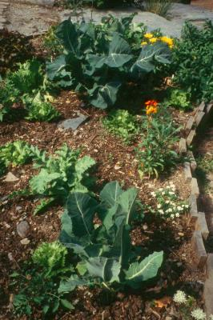
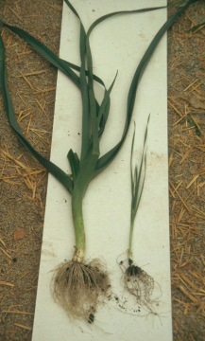
Some effects of regular applications of stored, dilute urine

Slide 28
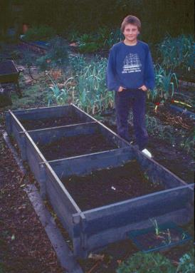
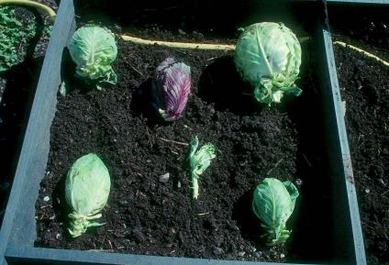
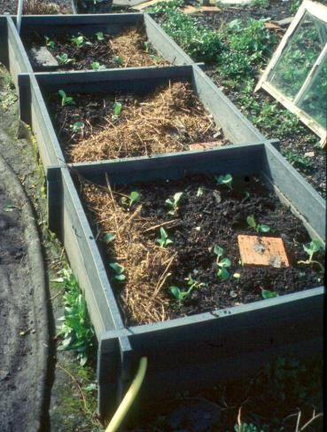
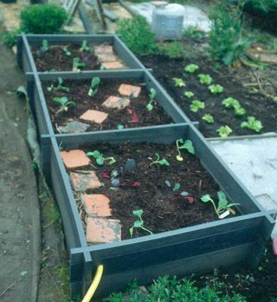

Slide 29
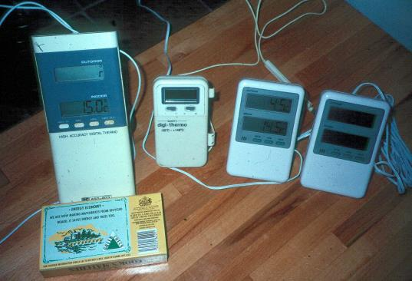

Slide 31
ORGANIC WASTE AND COMPOSTING

Slide 32
ADUSTED FOR ENVIRONMENTAL IMPACT

Slide 37
DESIGNING A COMPOST BIN FOR SOFT WASTES
Flat aspect ratio
Half lid
10mm grille base and door
Moveable insulation cover

Slide 38
House
Existing system for on-site nutrient recovery
Garden

Slide 39
TWO AWKWARD QUESTIONS
Are we trying to design lifestyles?
Are we trying to co-design a national strategy?

Slide 40
Figure 2. Carbon emissions per head attributable to various household processes. For the example households in the text the whole-household levels would be four times the per capita levels here. For context, the UK 2050 target is around 4t per head, the IPCC target 2t.

Slide 41
The green communities act as an ‘attractor’ to accelerate overall emission reductions
There is positive interaction between the two green communities

