Slide 1
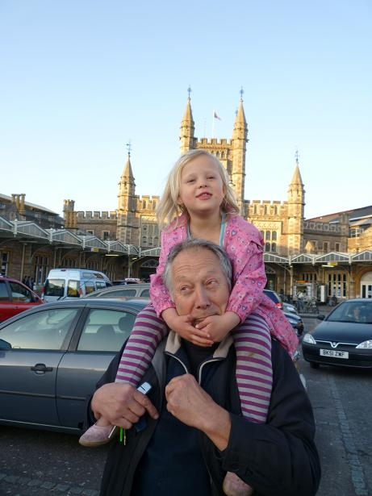
THE NEXT FIFTY YEARS
Good Grief!
Peter Harper
Centre for Alternative Technology

Slide 2
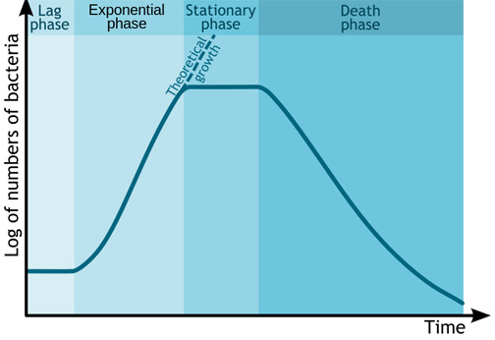
Source: http://www.scienceprofonline.com/vmc/microbial-growth-main.html

Slide 3
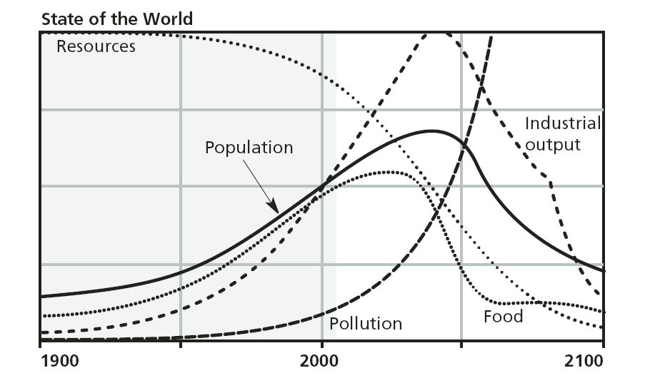

Slide 4
NOT BACTERIA
The world did not come to an end
Population growth rate slowed
The Green Revolution saw off the shade of Malthus
Minerals did not run out, and were fairly easily substituted. New materials appeared regularly
Environment ministries, agencies and regulations appeared everywhere
Clean air, rivers, workplaces
Nature conservation, protected areas
CFCs and the ozone hole

Slide 5
THE REVISIONIST VIEW Smooth transition is possible
6-7 billion people
“Aggregated environmental impacts”,
1-2 billion people
20th century
21st century

Slide 6
THE CLIMATE CHANGE ERA KICKS IN
GHG emissions
20th century
21st century

Slide 7
PHYSICAL REQUIREMENT TO RESTORE SMOOTH TRANSITION
6-7 billion people
“Aggregated environmental impacts”,
GHG emissions are a good proxy
1-2 billion people
20th century
21st century

Slide 8
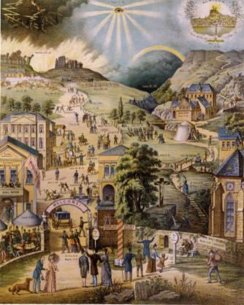

Slide 9
1972

Slide 10
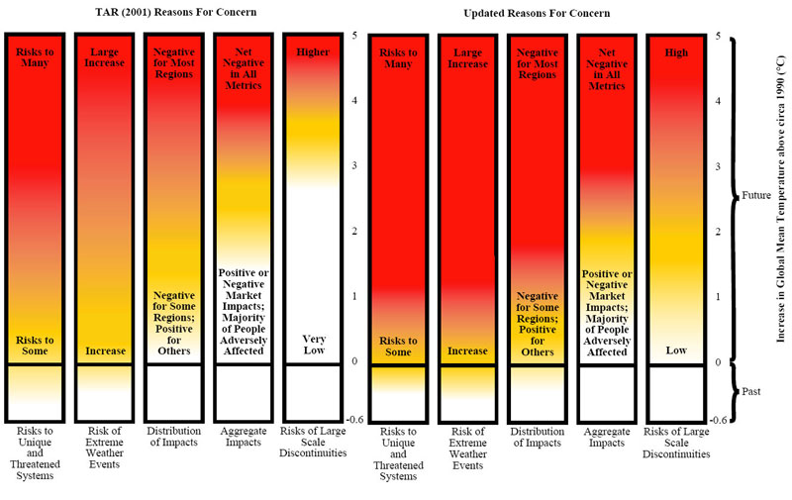
THE PROBLEM IS DEEPENING and 2°C is already ‘dangerous’

Slide 11
6°C
4°C
2°C

Slide 12
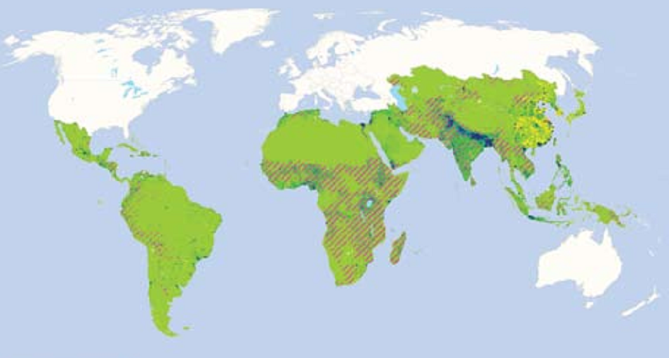
AN APOCALYPTIC CATALOGUE OF 4°C With far stronger impacts in tropics
More frequent and stronger droughts, floods, hurricanes
Sea level rise
Widespread and persistent crop failures
Famines and mass migrations
Heat waves
Damaged operation of ecosystem services
Widespread habitat and species extinctions
Water and resource wars
State collapse, control by local warlords
Restricted operation of UN and international systems
Very selective emergency aid – ‘triage’
Rise in terrorism and security expenditures, nuclear materials
The ‘New North’
Hotspots – predictions and action. Jock Baker, Charles Ehrhart and David Stone. Forced Migration Review #31, Oct 2011

Slide 13
THE NEW NORTH …more moral ironies
Hotspots – predictions and action. Jock Baker, Charles Ehrhart and David Stone. Forced Migration Review #31, Oct 2011

Slide 14
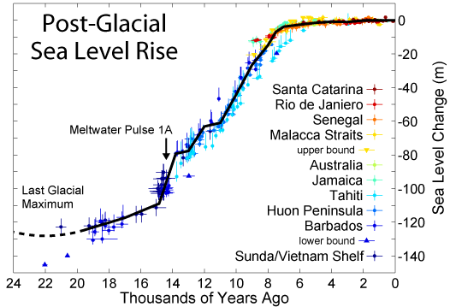
STABILITY OF HOLOCENE CLIMATE

Slide 15
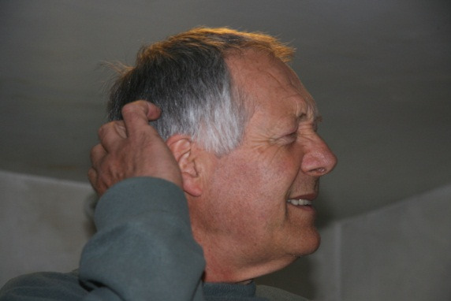
THE HOLOCENE
THE NEO-HOLOCENE
THE ANTHROPOCENE
THE MISANTHROPOCENE

Slide 16
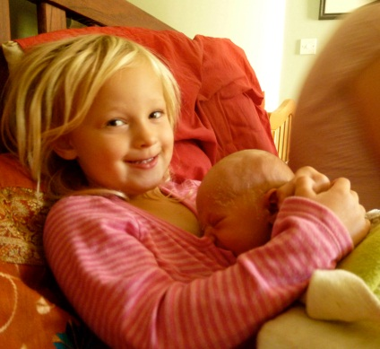

Slide 17
The ‘New North’/collapse conversation
The No Nukes conversation
The Geoengineering
conversation
The Try Everything conversation
The civilised values conversation

Slide 18
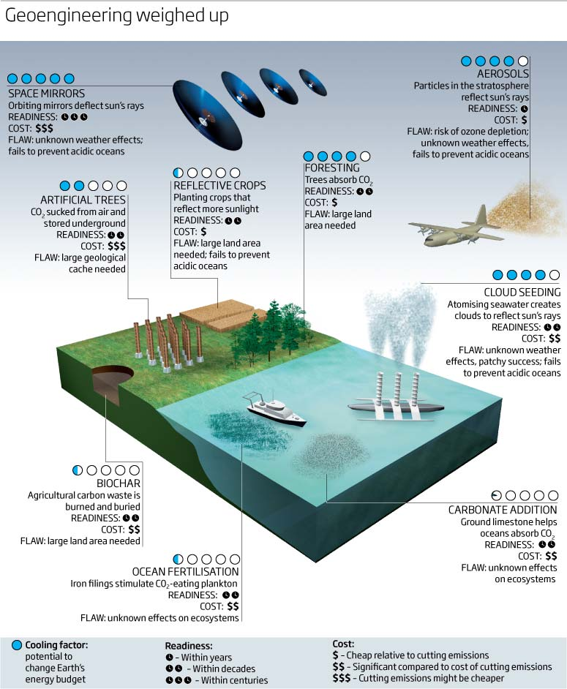

Slide 19
The No Nukes conversation
The Geoengineering
conversation
The Try Everything conversation
The Rolls-Royce conversation

Slide 20
Peter Harper
Centre for Alternative Technology

Slide 22
FURIOUS ACTIVITY
ZCB
POLITICAL REALISM
PHYSICAL REALISM
THE YAWNING CHASM

Slide 23
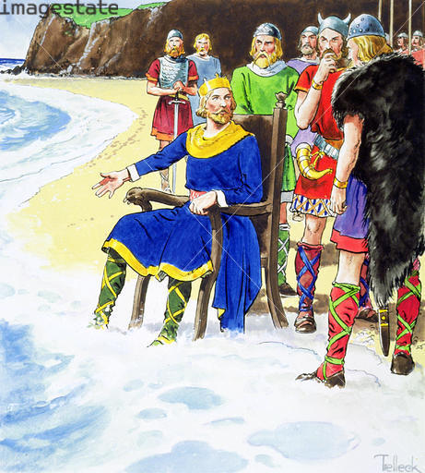
Well guys, it looks as if we have a result
Physics Trumps Politics
Credit: © Stapleton Historical Collection / Heritage-Images / Imagestate

Slide 24
‘PHYSICALIST’ VIEW
Insistence on maintaining the status quo eventually destroys it
Applying necessary adjustments and living with some limitations maintains as much as possible of the status quo
COSTS, RISKS, EFFORT, AND GENERAL UNPLEASANTNESS
TIME, 21ST CENTURY

Slide 26
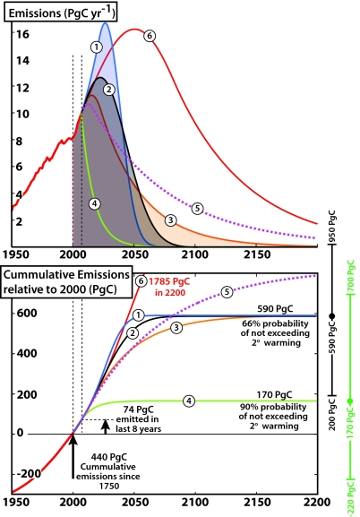
Proc Natl Acad Sci U S A. 2009 September 29; 106(39): 16539–16540. Published online 2009 September 22. doi: 10.1073/pnas.0908197106 PMCID: PMC2757854 Constraining future greenhouse gas emissions by a cumulative target Matthew H. England,¹ Alexander Sen Gupta, and Andrew J. Pitman

Slide 27
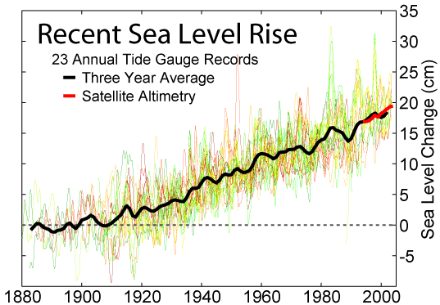
RECENT DEVIATION FROM ATTRACTOR

Slide 28
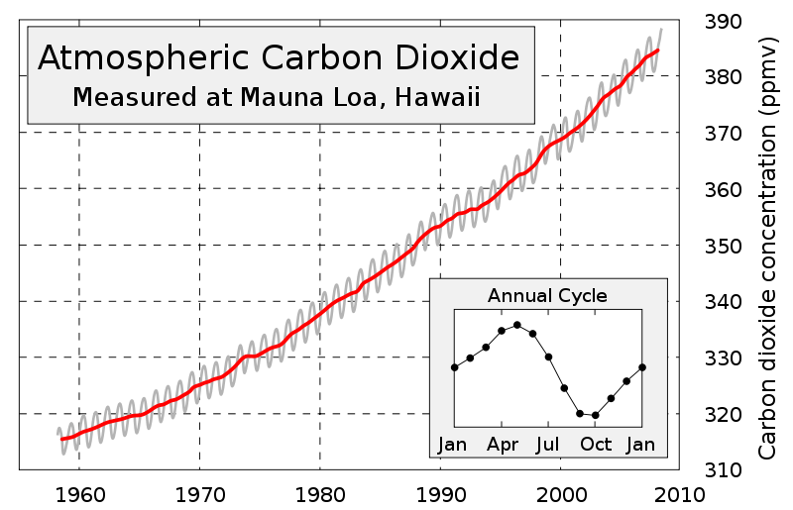
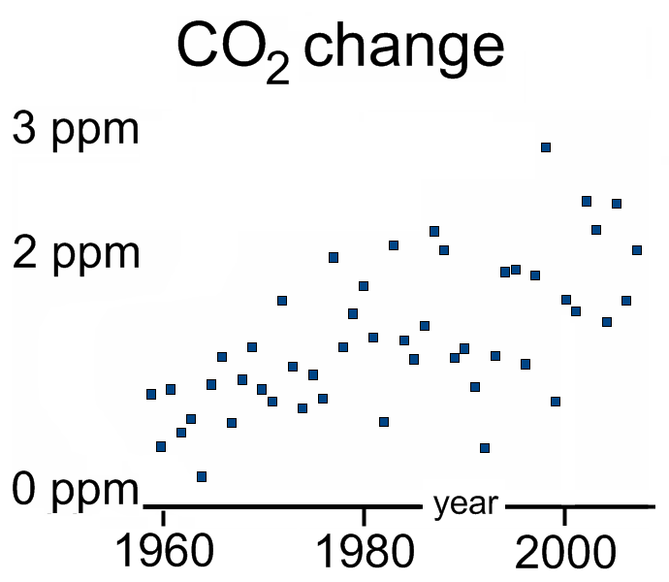
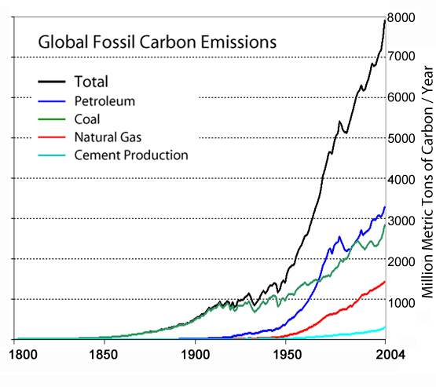
KEELING CURVE

Slide 29
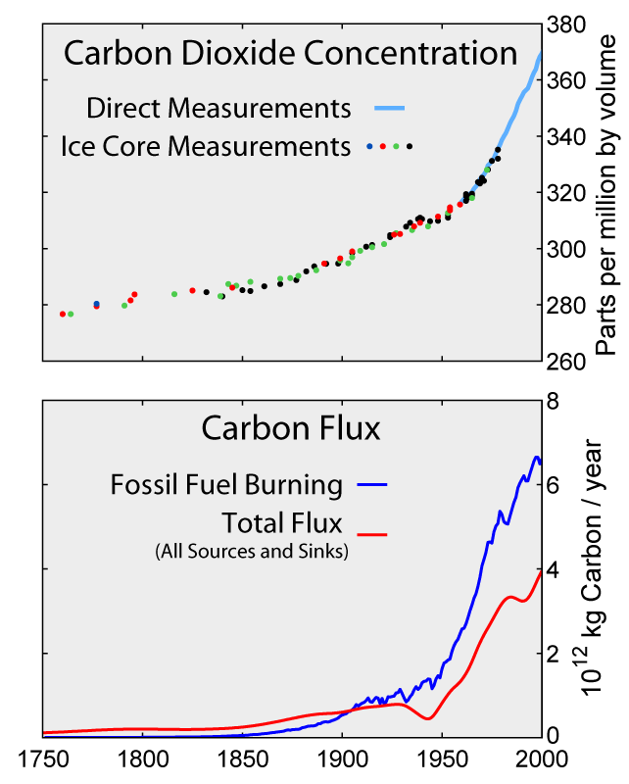
A GOOD BACKGROUND PAIR

Slide 30
MY PERSONAL IMPRESSION OF ‘URGENCY’ – PROBABLY REPRESENTATIVE OF THE WIDER ENVIRONMENTAL MOVEMENT
CLIMATE CHANGE ERA
‘FIRST WAVE’
ERA OF EVIDENCE-BASED REASSESSMENT
LINEAR MODELS
RISK-OF-FEEDBACK MODELS
ERA OF ‘PRECAUTIONARY PESSIMISM’
MORE ‘PRECAUTIONARY PESSIMISM’

Slide 31
How Many People Can the World Support? John Heaver Fremlin (1913-95) New Scientist, No. 415, 285-287, 1964
Years from ‘now’ | Doublings | Population, billions
260 | 7 | 400
370 | 10 | 3000
450 | 12 | 15,000
680 | 15 | 1,000,000
800 | 18 | 12,000,000

