Slide 1
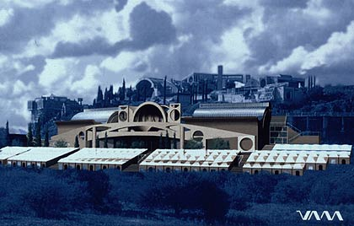
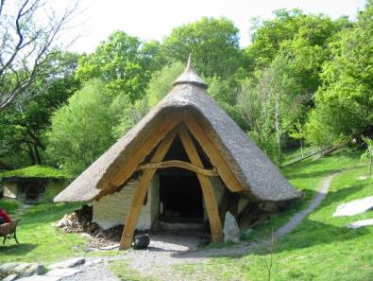
ECOVILLAGES WHAT? WHERE? HOW?
Centre for
Alternative Technology
Peter Harper
www.cat.org.uk
peter.harper@cat.org.uk

Slide 2
WHAT IS AN ECOVILLAGE NOW?
Environmental features
Not a house
Not a town
We can still learn a lot from eco-houses and eco-towns, but we are talking mid-scale
“Full-featured community” is probably too high a standard yet
Probably better to use terms like
‘eco-neighbourhood’ or
‘sustainable development scheme’

Slide 3
Where do they fit?
Eco-technologies
Eco-buildings
Eco-settlements/neighbourhoods/villages
Eco-towns/cities
Eco-nations
Eco-planet

Slide 4
ENVIRONMENTAL FEATURES Two kinds, important to distinguish
Ones that benefit occupants directly
Ones that merely save the planet, possibly at some apparent cost to occupants

Slide 5
ECO-FEATURES THAT BENEFIT OCCUPANTS (an active area of debate)
Class I:
that occupants recognise, appreciate, and will readily pay for
Conservatory
Special glazing
Wood stove
Pond
Advanced taps and sanitary fittings
Solar water heating?
Class II:
that occupants might not respond to without prompting
Solar water-heating?
Low allergen furnishings, paints and varnishes?
Condensing boilers
Radon control
High insulation
Car-share systems
Good public transport links

Slide 6
Hard-to-sell eco-factors
Low-carbon materials
Recycled insulation materials
Photovoltaics
FSC timber certification
Porous surfaces for rain infiltration
Restrictions on private vehicles
Waterless toilets
Shared facilities

Slide 7
THIS MAKES A DIFFERENCE TO THE ENVIRONMENTAL FEATURES OF AN ECOVILLAGE
A highly motivated ideological group can take on ‘costly’ ‘world-saving’ measures
But obviously this is more difficult for local authority or commercial developers to impose on occupants
…with obvious implications for mainstreaming eco-settlements

Slide 8
WHO’S DRIVING?
 |  | PROJECT STAGES
 |  | INITIATE | PLAN | IMPLE-MENT | MAINTAIN
LEVEL OF OCCUPANT INVOLVEMENT | SELF HELP | Occupants control the project and do it themselves
 | PARTNERSHIP | Working and decision-making shared between developer and occupants
 | CONSULTATION | Developers seek opinions and feedback from occupants
 | INFORMATION | Developer initiates, with information to occupants where appropriate

Slide 9
 | ECO-MEASURES WITH MATERIAL BENEFITS | ECO-MEASURES WITHOUT MATERIAL BENEFITS
OCCUPANT CONTROL | Communities with social/cultural/spiritual aims Co-housing schemes | Ideological ecovillages
DEVELOPER CONTROL | Varied partial responses to the sustainability agenda | ?

Slide 10
 | ECO-MEASURES WITH MATERIAL BENEFITS | ECO-MEASURES WITHOUT MATERIAL BENEFITS
OCCUPANT CONTROL | Communities with social/cultural/spiritual aims Co-housing schemes | Ideological ecovillages
DEVELOPER CONTROL | Varied partial responses to the sustainability agenda | Cunning plans ‘No regrets’ double functions Wow-factors Financial incentives

Slide 11
Some examples of ideological, community-controlled ecovillages “People First”

Slide 12
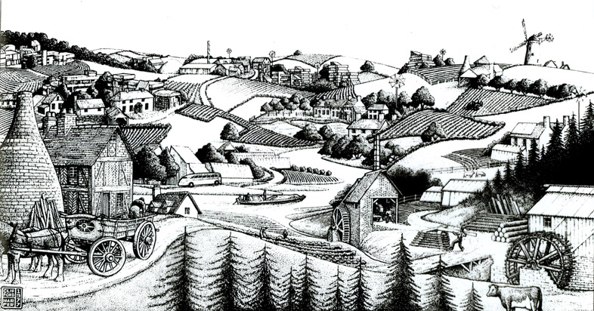
(starting with heroic seventies fantasies)

Slide 13
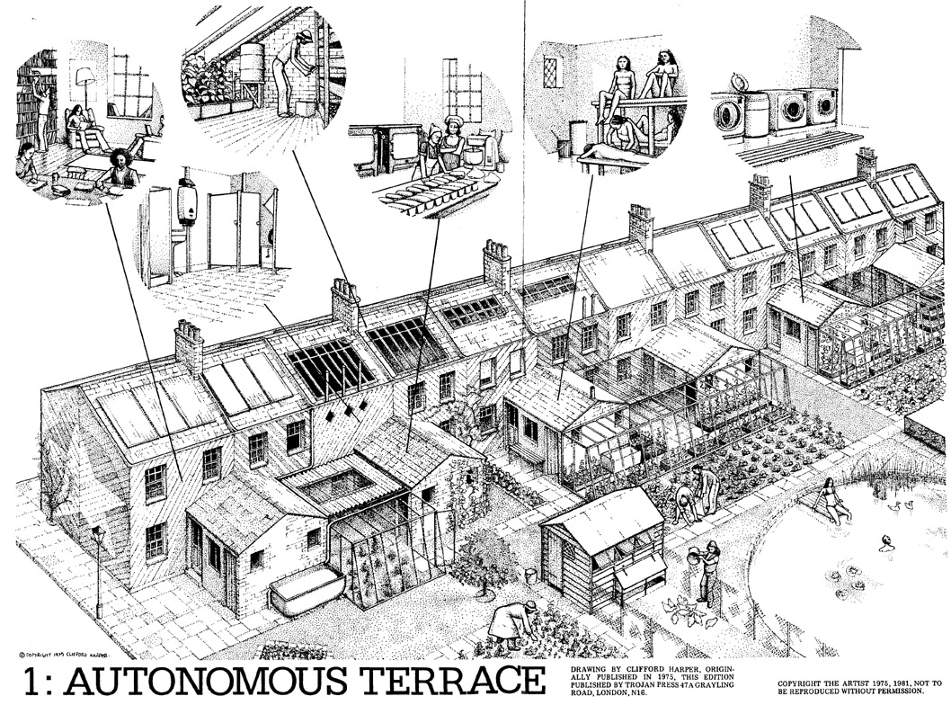

Slide 14
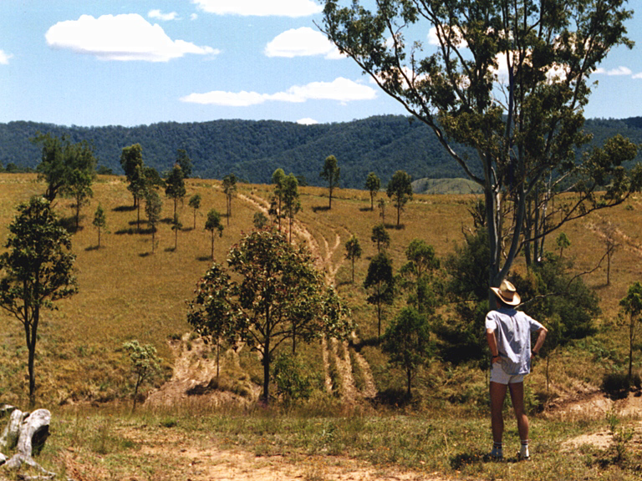
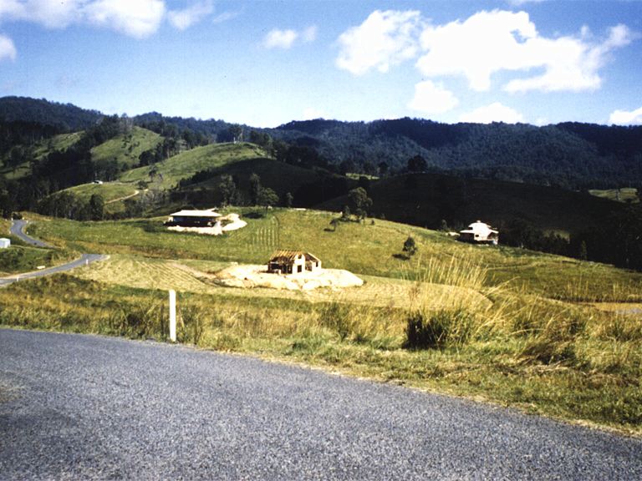
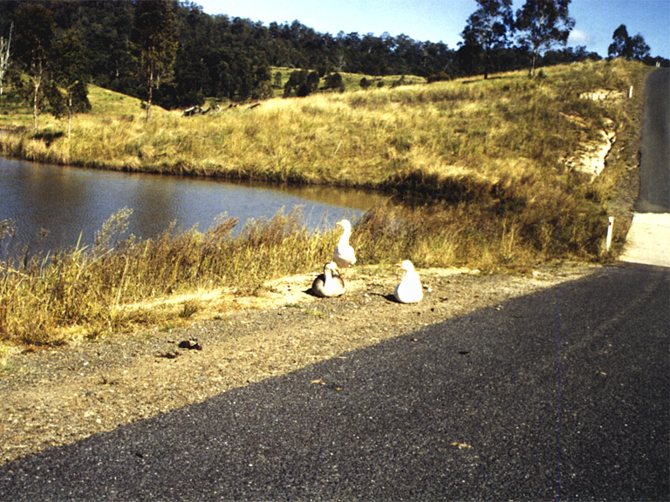
CRYSTAL WATERS, Australia 1989
Rural Location
150 inhabitants
New-build
Explicit eco by-laws from outset
Infrastructure installed first
Density high by Australian standards
Designed on ‘Permaculture’ principles

Slide 15
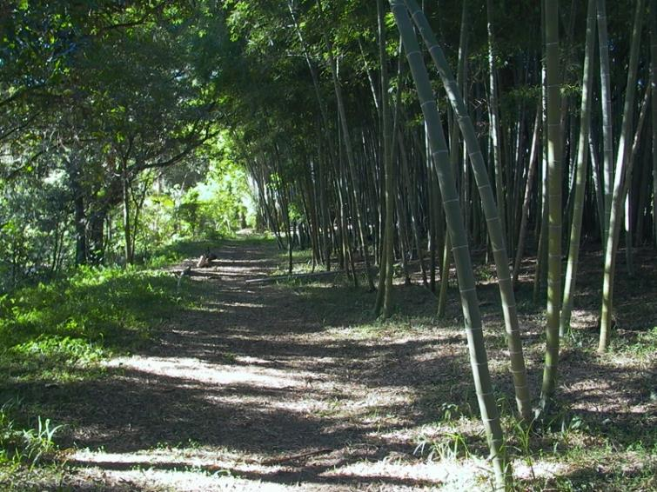
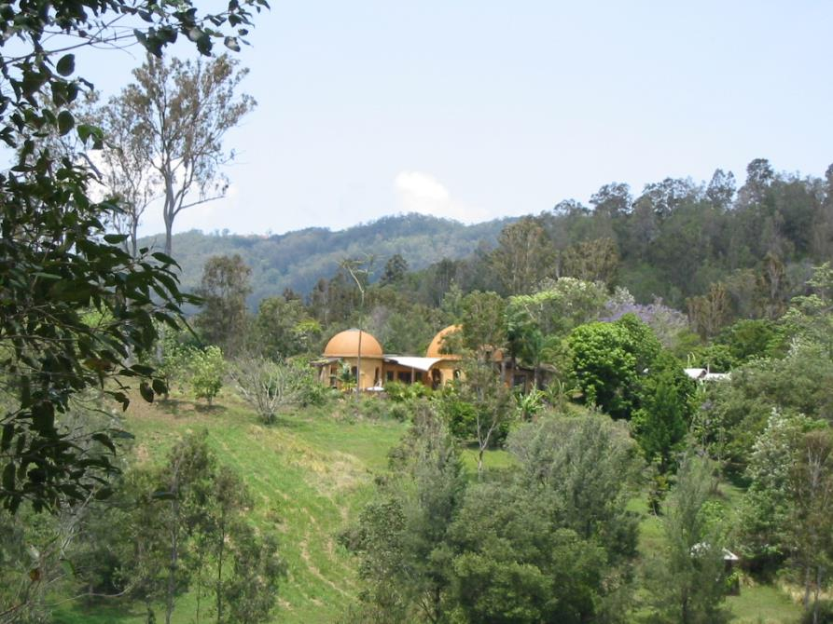
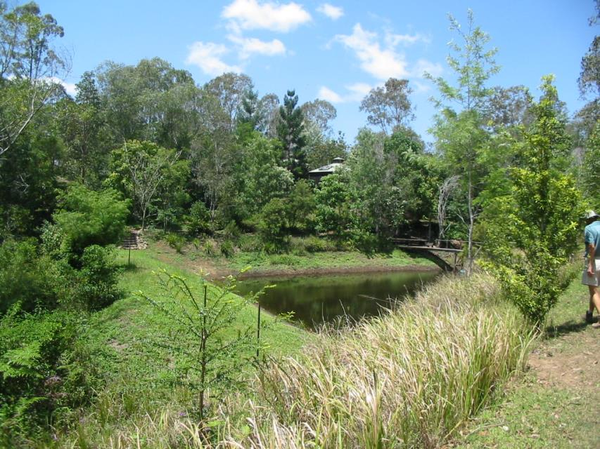
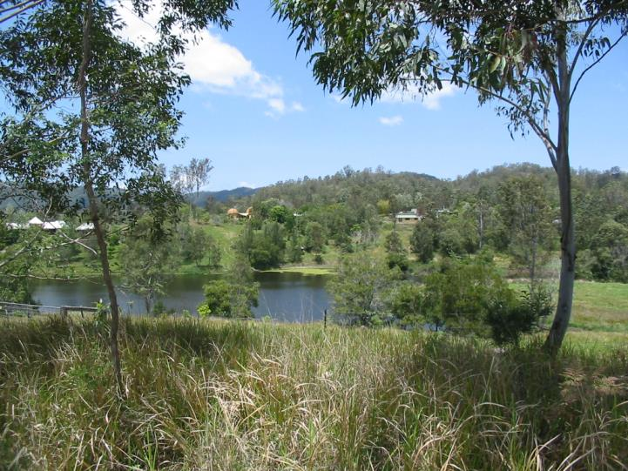

Slide 16
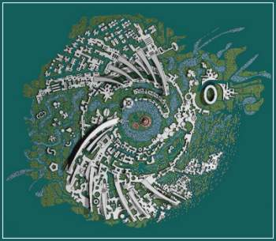
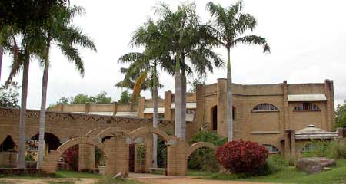
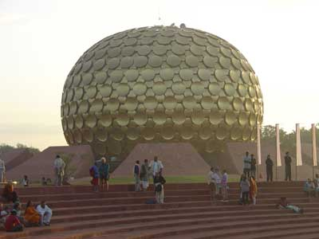
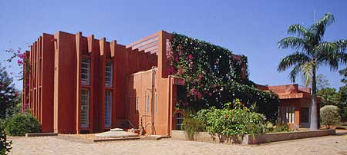
AUROVILLE, INDIA 1968
2000 inhabitants
Vigorous natural regeneration
Eclectic mix of new-build styles
Clusters of diverse ‘villages’

Slide 17
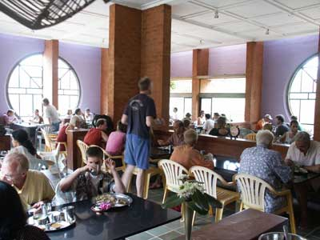
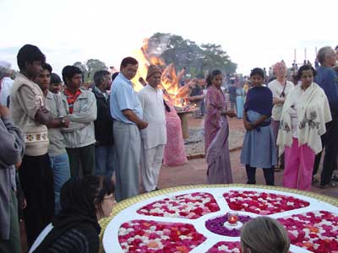
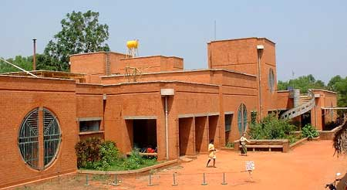
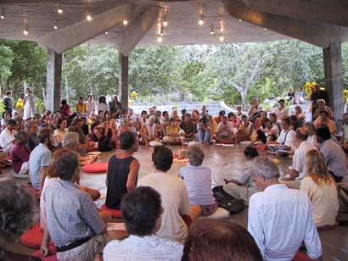
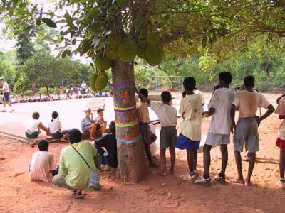
AUROVILLE
Multi-ethnic
A ‘full-featured’ community

Slide 18
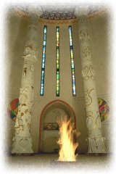
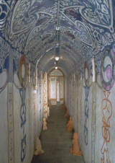
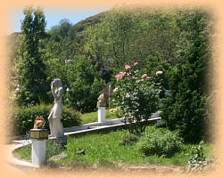
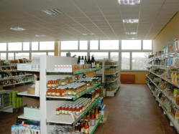
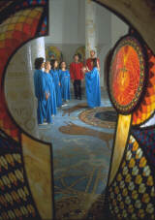
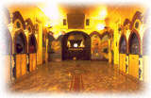
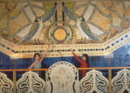
DAMANHUR, Italy 1977
1000 inhabitants
Rural location
Ideological basis
Full-featured
New-build

Slide 19
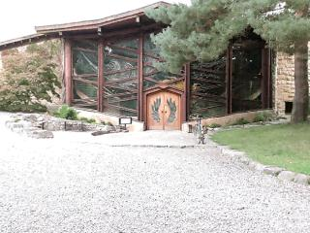
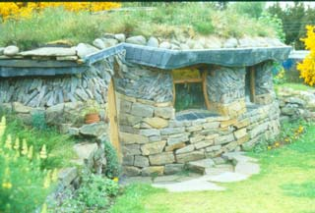
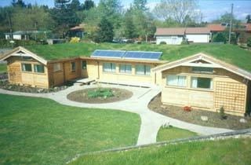
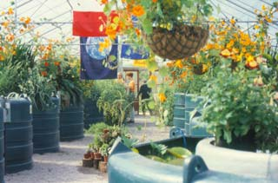
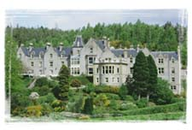
FINDHORN FOUNDATION, Scotland, 1962
Rural location
350 inhabitants, full-featured
Mostly new-build, many collective facilities
Spiritual basis, but recent environmental emphasis

Slide 20
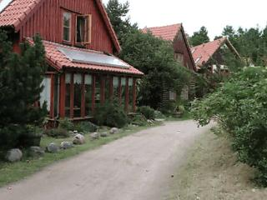
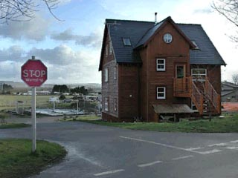
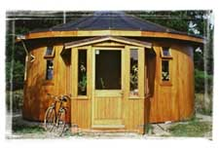
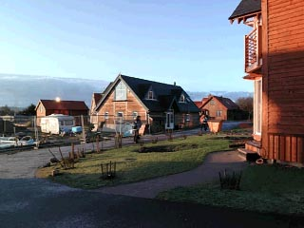
FINDHORN FOUNDATION
Variety of new-build styles, favouring neo-vernacular
Strict by-laws
Very high quality

Slide 21
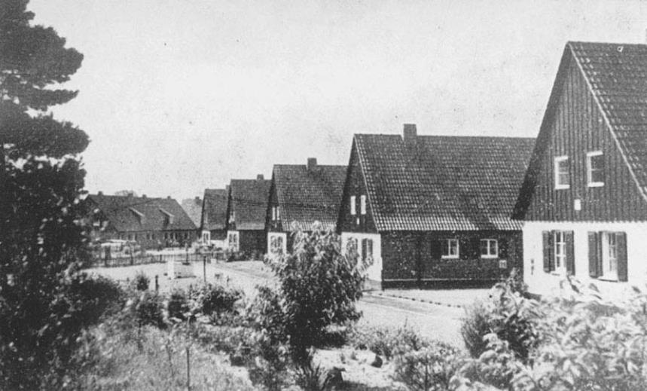
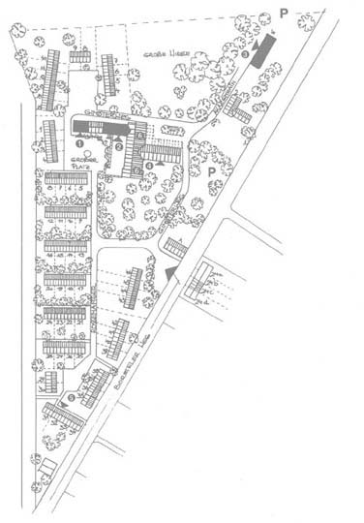
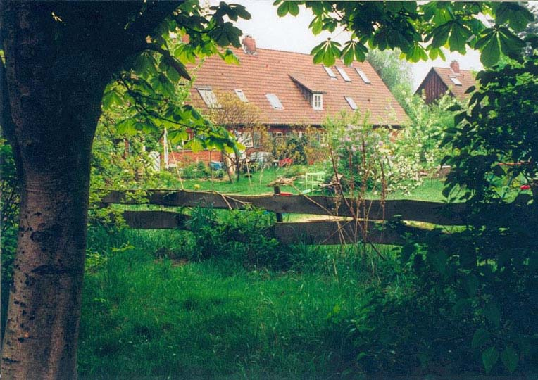
LEBENSGARTEN, Germany 1985
Pre-existing army camp
Urban location
150 inhabitants
Full-featured
Demonstration and education

Slide 22
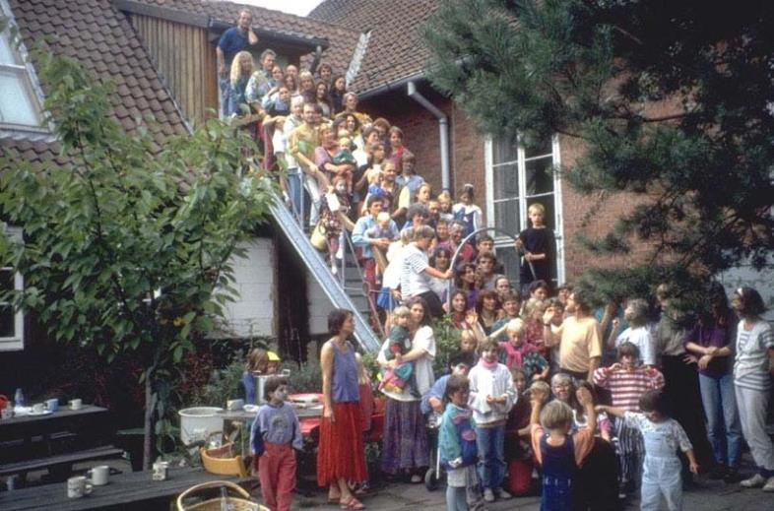
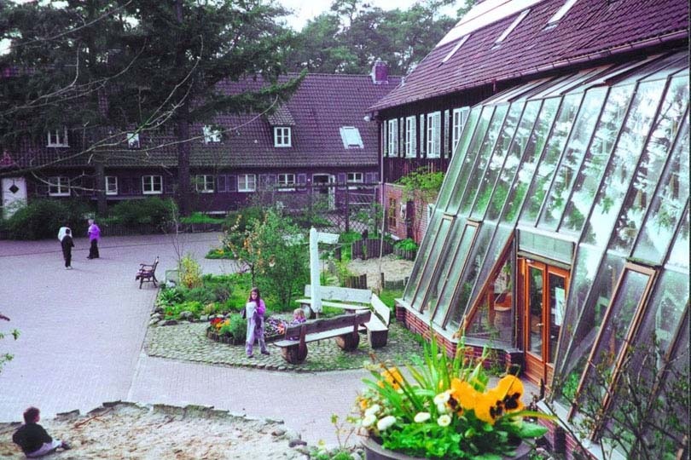
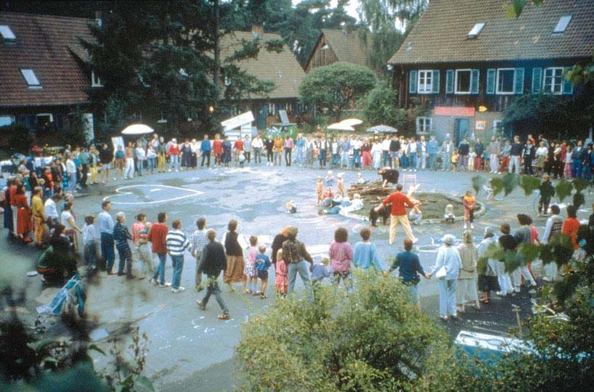
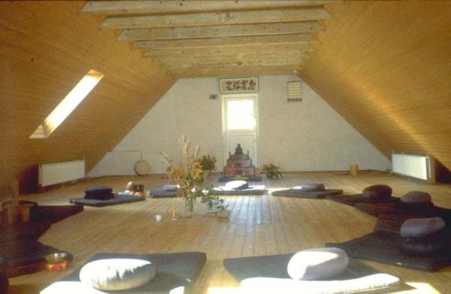
Private dwellings but strong provision for public spaces, facilities and events

Slide 23
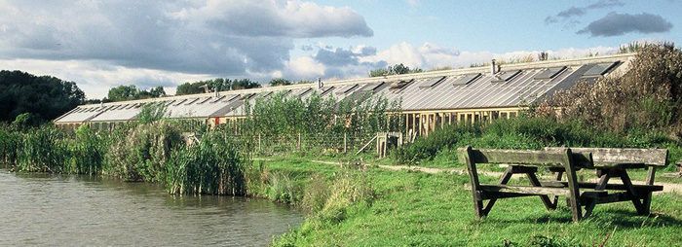
HOCKERTON HOUSING ASSOCIATION, UK 1999
Peri-urban location
5 households
New build, earth sheltered ‘terrace’
Many environmental features

Slide 24
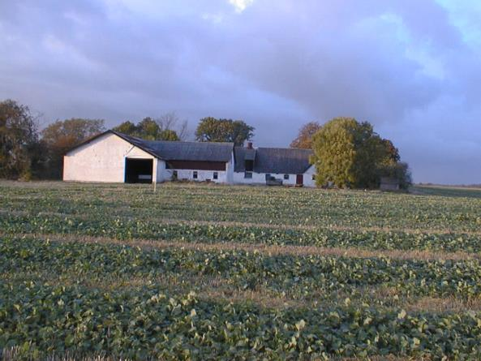
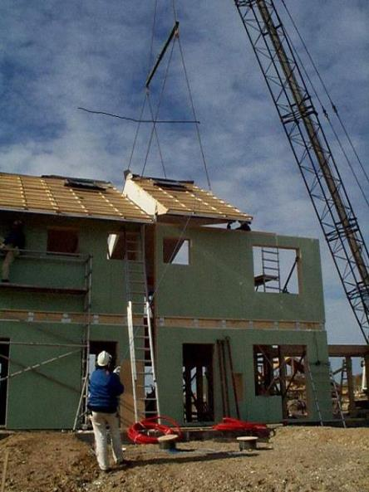
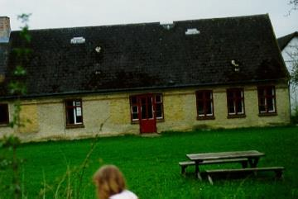
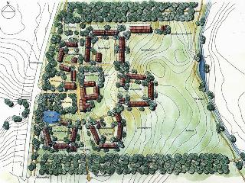
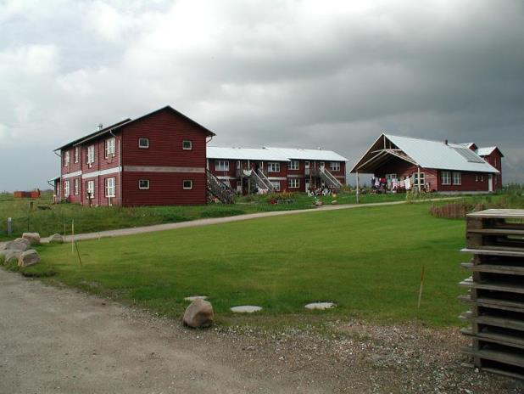
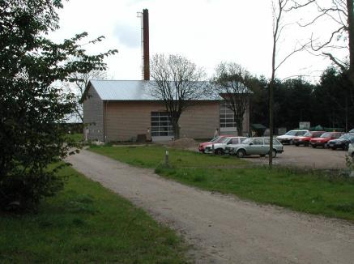
MUNKSØGAARD, Denmark 1995
Rural location
300 inhabitants
Co-housing model
Mostly new-build, around existing farmhouses
5 distinct clusters with different ownership and occupants
CHP/District Heating

Slide 25
STROUD COHOUSING COMMUNITY, UK 2000
Urban location
Cohousing model
20 households
New-build, solar orientation
Cite inspiration from Cohousing and A Pattern Language

Slide 26
DEVELOPER-LED OPTIONS “Bricks First”
ARE THESE TO BE REJECTED?
WHY?

Slide 27
A MUCH MORE CONVENTIONAL APPROACH:
HIGH-SPEC LOW-ENERGY HOUSES WITH TRADITIONAL APPEARANCE AND AMBIENCE

Slide 28
POUNDBURY, UK 1998-
100+ dwellings
Developer-led
Peri-urban location
High density
Neo-vernacular new-build
Good take-up

Slide 29
POUNDBURY
Style-conscious collective facilities
Few eco-features in individual buildings

Slide 30
VILLAGE HOMES, USA 1986
Suburban location
Commercial development
220 dwellings, new build
High density by expected standards
High proportion of common space
Passive solar layout
Vehicles discouraged
Innovative drainage arrangements

Slide 31
ECOLONIA, The Netherlands 1990
100 dwellings, new build
Developer-led, local authority
9 different house designs
Landscaped grounds, public space
Many environmental features

Slide 32
THE WINTLES, UK 2004
Peri-urban location in small rural town
Developer-led
New-build, neo-vernacular styles
Pedestrianised centre, no garages
Quasi-random layout in clusters
Common space among buildings, but more for allotments, woods and recreation in an adjacent area
Includes proportion of social housing
Acknowledged debt to A Pattern Language
Extra costs (>10%) mitigated by ‘wow factor’
No architect!

Slide 33
THE WINTLES
Non-eco
wow-factors
Eco non-wow factors

Slide 34
THE WINTLES
Generous windows, rooflights and conservatories
Roofspace always used
Choices for variable vertical and horizontal layout

Slide 35
THE WINTLES
Clustered layout and distinctive details

Slide 36
BedZED
Another story?

Slide 37
Striking appearance deriving from true function

Slide 38
Passive solar features using whole-elevation sunspace

Slide 39
Eco-features maintained on behalf of the residents
Wood-fuelled CHP
Living machine wastewater treatment

Slide 40
Eye-level meters in kitchen
Eco-features involving resident behaviour
Car-share scheme
Electric vehicles

Slide 41
Studios/workshops/live-work spaces to offset extra building costs

Slide 42
Small private gardens and public space

Slide 43
ANY CONCLUSIONS?
Which is doing better in environmental terms….
People first ? or
Bricks first ?
At this point we meet the large-scale city planning system coming the other way…
With principles like ‘New Urbanism’ and ‘The Freiburg Consensus’
Is top-down or bottom up better?

Slide 44
THE ‘FREIBURG CONSENSUS’ 1995
Heterogeneous social composition with special attention to the needs of children, elderly and low-income groups
A pedestrian-dominated public realm to provide an attractive human-scale environment and facilitate ‘good social life’
Diversity of use—housing, work, shopping, civic, cultural and health facilities—in a fine-textured, compact, low-rise urban fabric
Active and frequent participation of all segments of the population in planning and design of the area
Architectural identity that is rooted in the collective memory of the region
Pedestrian, bicycle and public transport networks within the neighbourhood and linking to the city as a whole, discouraging automobile use
Ecologically responsible development principles cutting energy use and pollution

