Slide 1
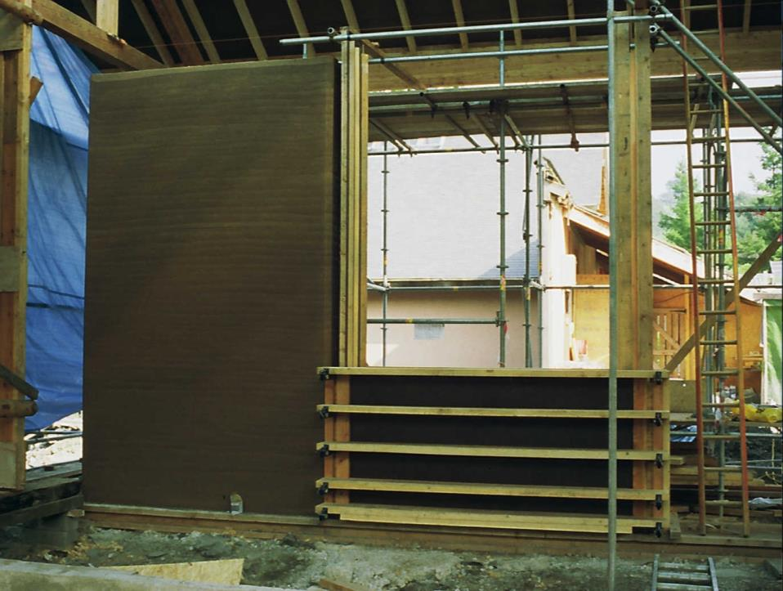
BUILDING ON EXPERIENCE 30 years of ‘Alternative Technology’ with a special emphasis on construction
Peter Harper
Centre for Alternative Technology

Slide 2
WE’LL BE LOOKING AT
Water and sanitation
Energy
Building

Slide 3
CAT Water Supply System
Storage tank
Sand filter
Hydroelectricity and irrigation
Reservoir
Filtered water
Unfiltered water
UV filter
Filter
Staff houses
Restaurant
Shop
Ceramic filter
Storage tank
Toilets

Slide 4
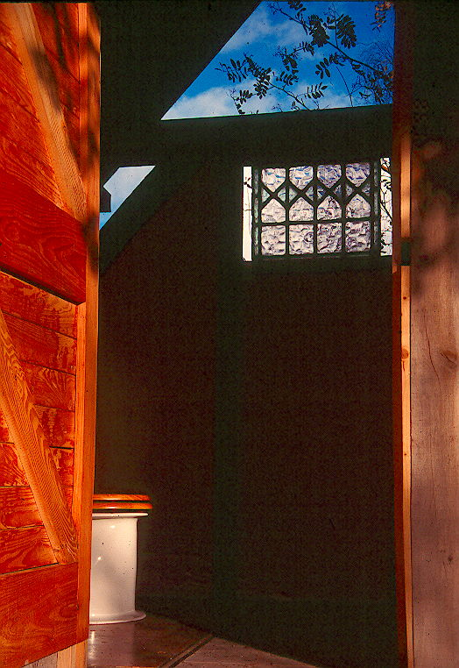
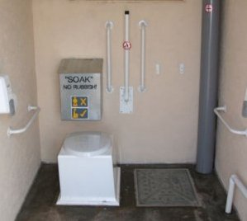
WATERLESS TOILETS: NOW A MATURE NICHE TECHNOLOGY?
www.natsol.co.uk

Slide 5
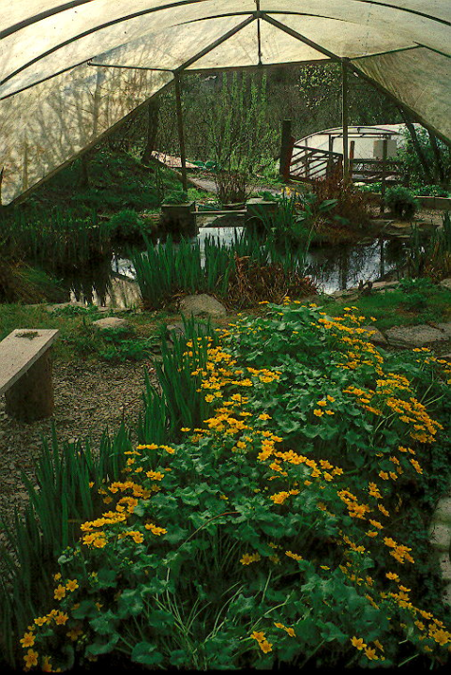
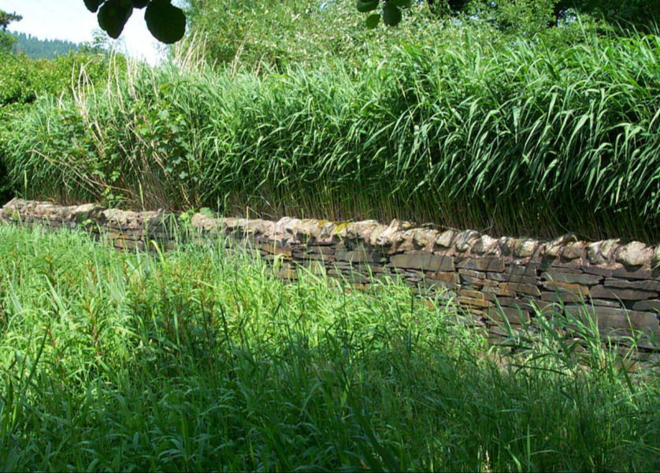
Constructed wetlands – another mature technology?

Slide 6
SUMMARY FOR WATER
Whole cycle using on-site sources and sinks
Virtually no energy input, just gravity
Simple plumbing, very few moving parts
Chlorine-free drinking water
Cleaning using simple biological processes, no chemicals
Some nutrient recovery
Positive addition to habitat and biodiversity
Brilliant – but probably a special case

Slide 7
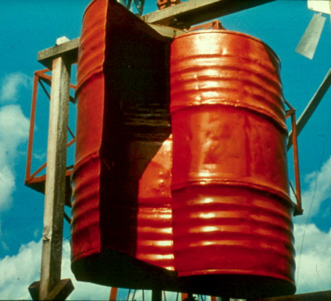
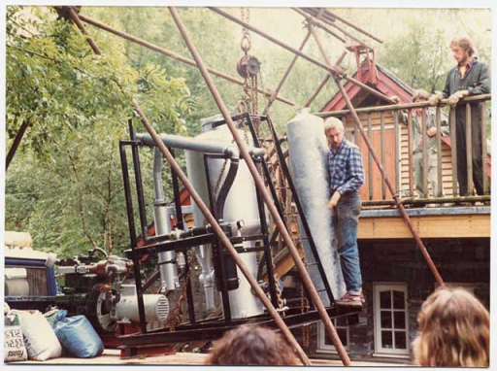
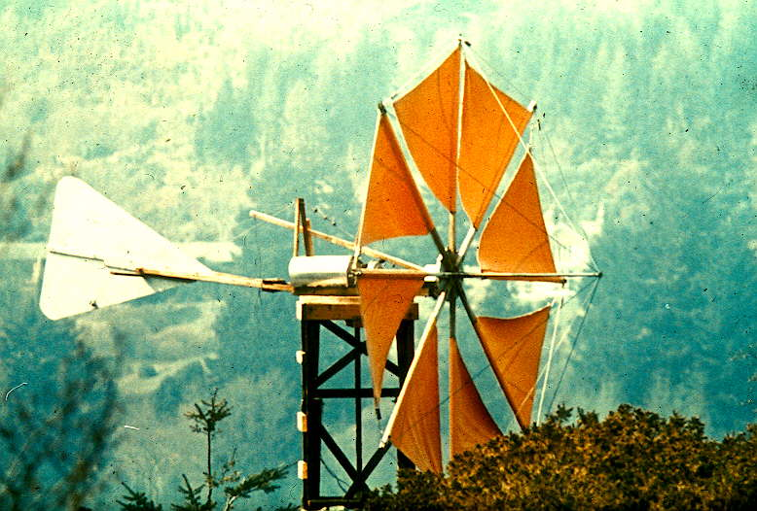
ENERGY: SOME SUCCESSES, MANY FAILURES

Slide 8
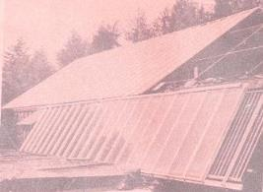
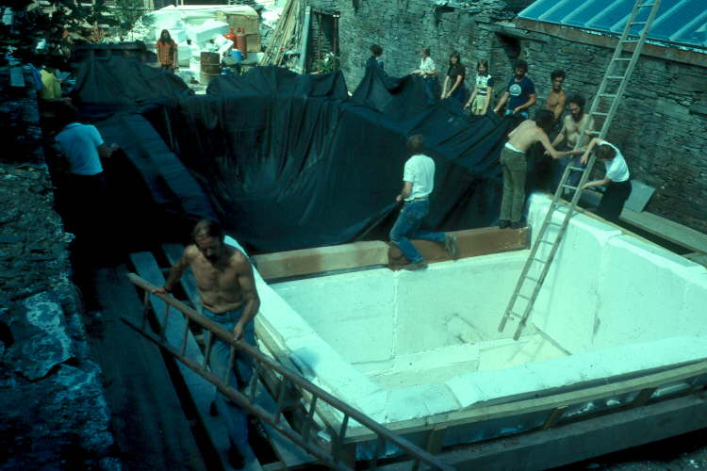
INTER-SEASONAL SOLAR SPACE HEATING

Slide 9
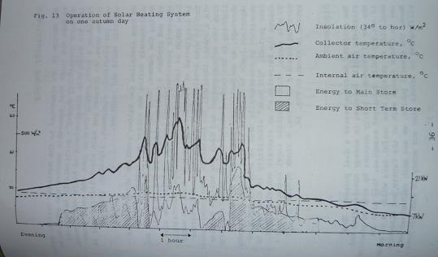
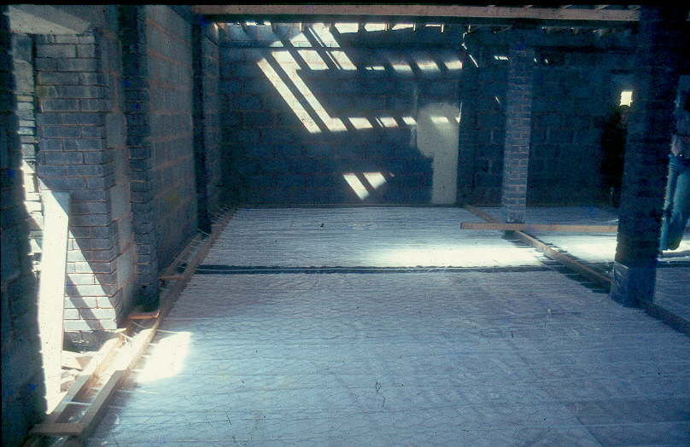
AMBITIOUS AND WELL AHEAD OF ITS TIME EVENTUALLY SUCCUMBED TO THE CINDERELLA EFFECT

Slide 10
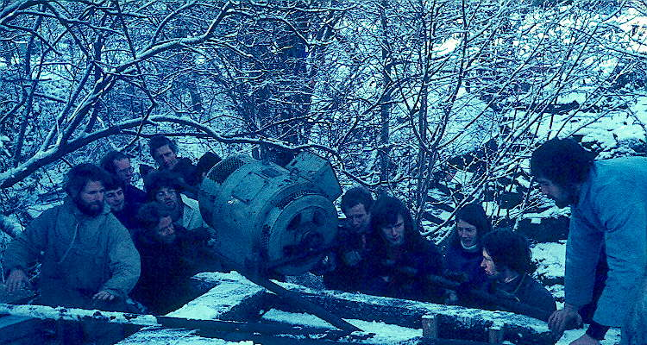
MICRO-HYDRO: EXTREMELY RELIABLE, LASTED THE COURSE, COST-EFFECTIVE But invariably a special case

Slide 11
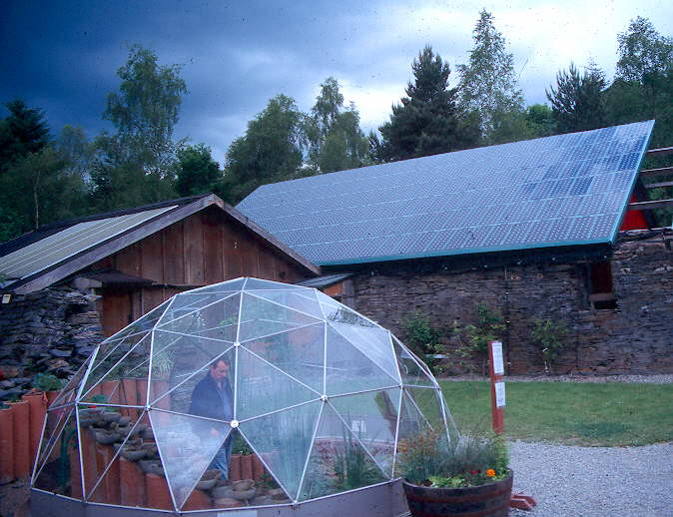
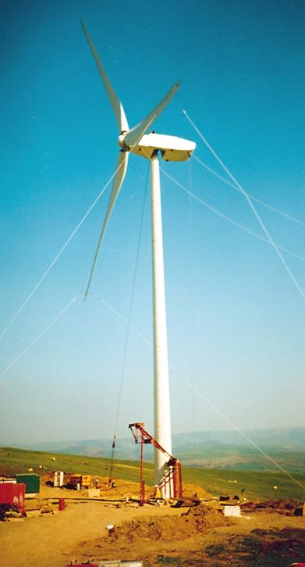
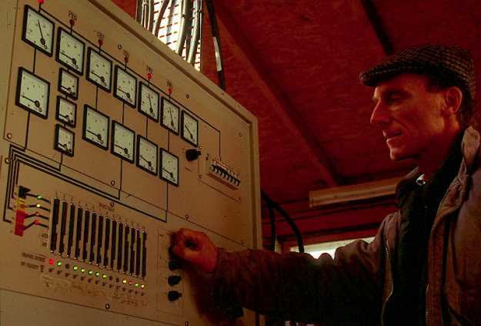
AUTOMATION IS A KEY FEATURE
Photovoltaic roof
Grid-linked wind turbine
Water-balanced funicular railway at CAT, Wales

Slide 12
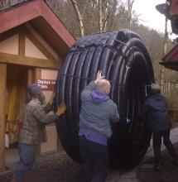
IT’S SYSTEMS AS MUCH AS SPECIFIC TECHNOLOGIES: DISTRICT HEATING
AtEIC Building (20kW)
Restaurant
(30kW)
Staff House and Wates
(12kW)
Courses
House
(10kW)
Top Station (8kW)
112m sq. Solar Array
Back up LPG Boiler 33kW
Back up LPG Boiler
Back up LPG Boiler 22kW
Woodchip/
pellet Boiler 50kW
5000l heat store
Underfloor heating in AtEIC

Slide 13
ENERGY SOURCES AT CAT The slow defeat of the small as demand outstrips a fixed site Sources listed in ranked order of their contribution
1970s | 1980s | 1990s | 2000s | 2010s
20 P.E. | 40 | 80 | 110 | 150
ELECTRICITY |  | GRID LINKED
Micro-Hydro, Bottled gas to generator wind PV | Micro-hydro diesel CHP wind Wood gasifier PV | Grid connection Diesel generator Wind Micro-hydro PV | Grid connection Wind Diesel generator Micro-hydro, PV | Failed wood-fuelled CHP Grid connection PV Micro-hydro Wind
HEATING AND COOKING
Coal Wood, Solar thermal Bottled gas | Wood, Bulk gas Wind dump Diesel CHP Solar thermal | Wood DH Log stoves Bulk gas Wind dump Solar thermal | Wood DH Bulk gas Log stoves Pellet stoves Solar thermal | Bulk gas Wood DH Log stoves Pellet stoves Solar thermal

Slide 14
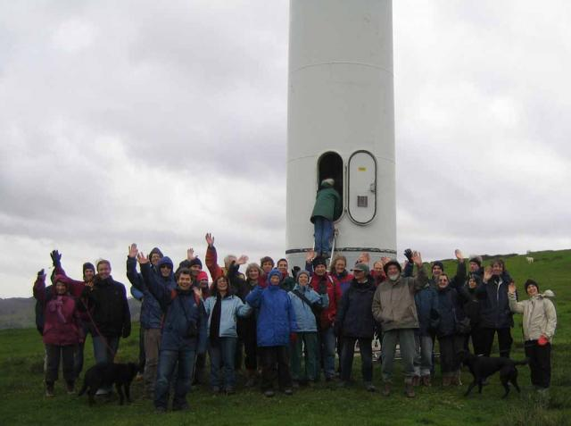
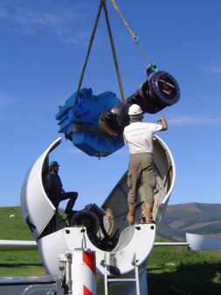
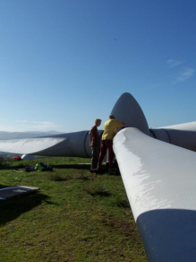
“OFFSETS” Excellent community projects, but even here small scale can be a disadvantage

Slide 15
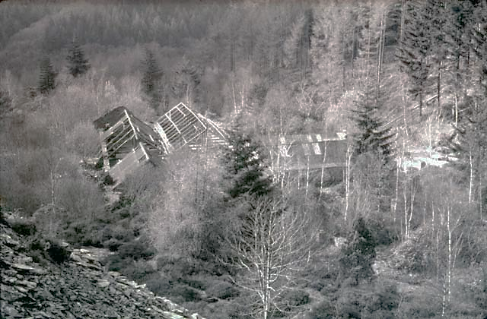
BUILDINGS: THE START

Slide 16
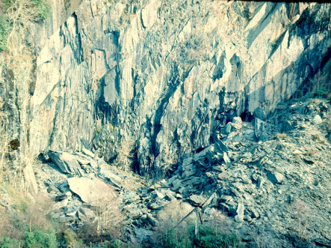
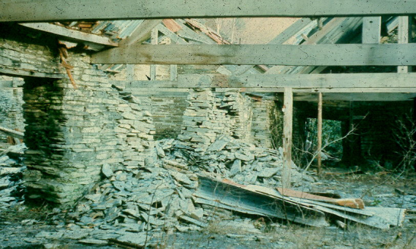
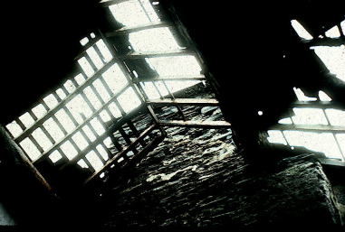
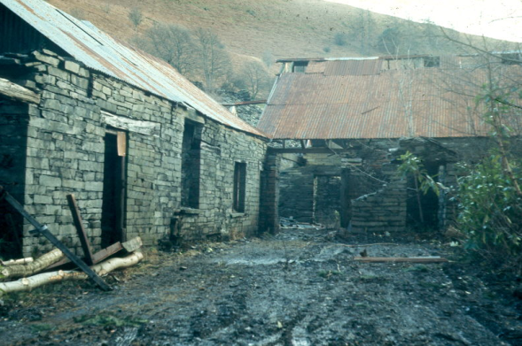

Slide 17
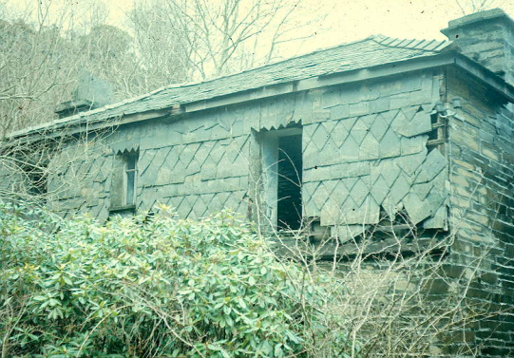
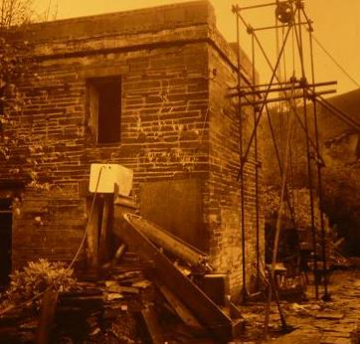
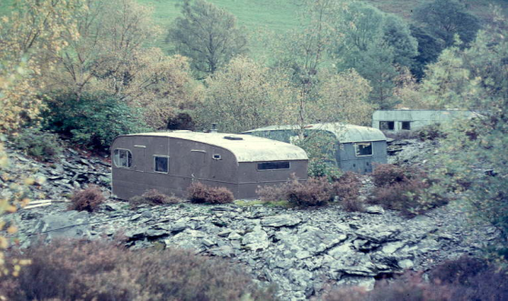

Slide 18
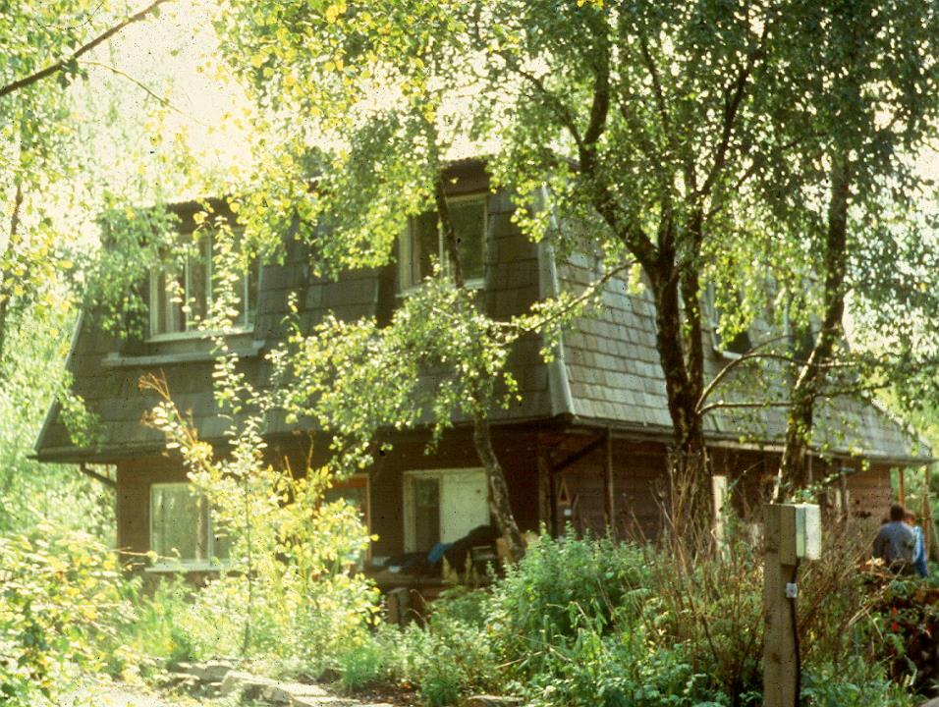
NEXT PHASE Trying everything

Slide 19
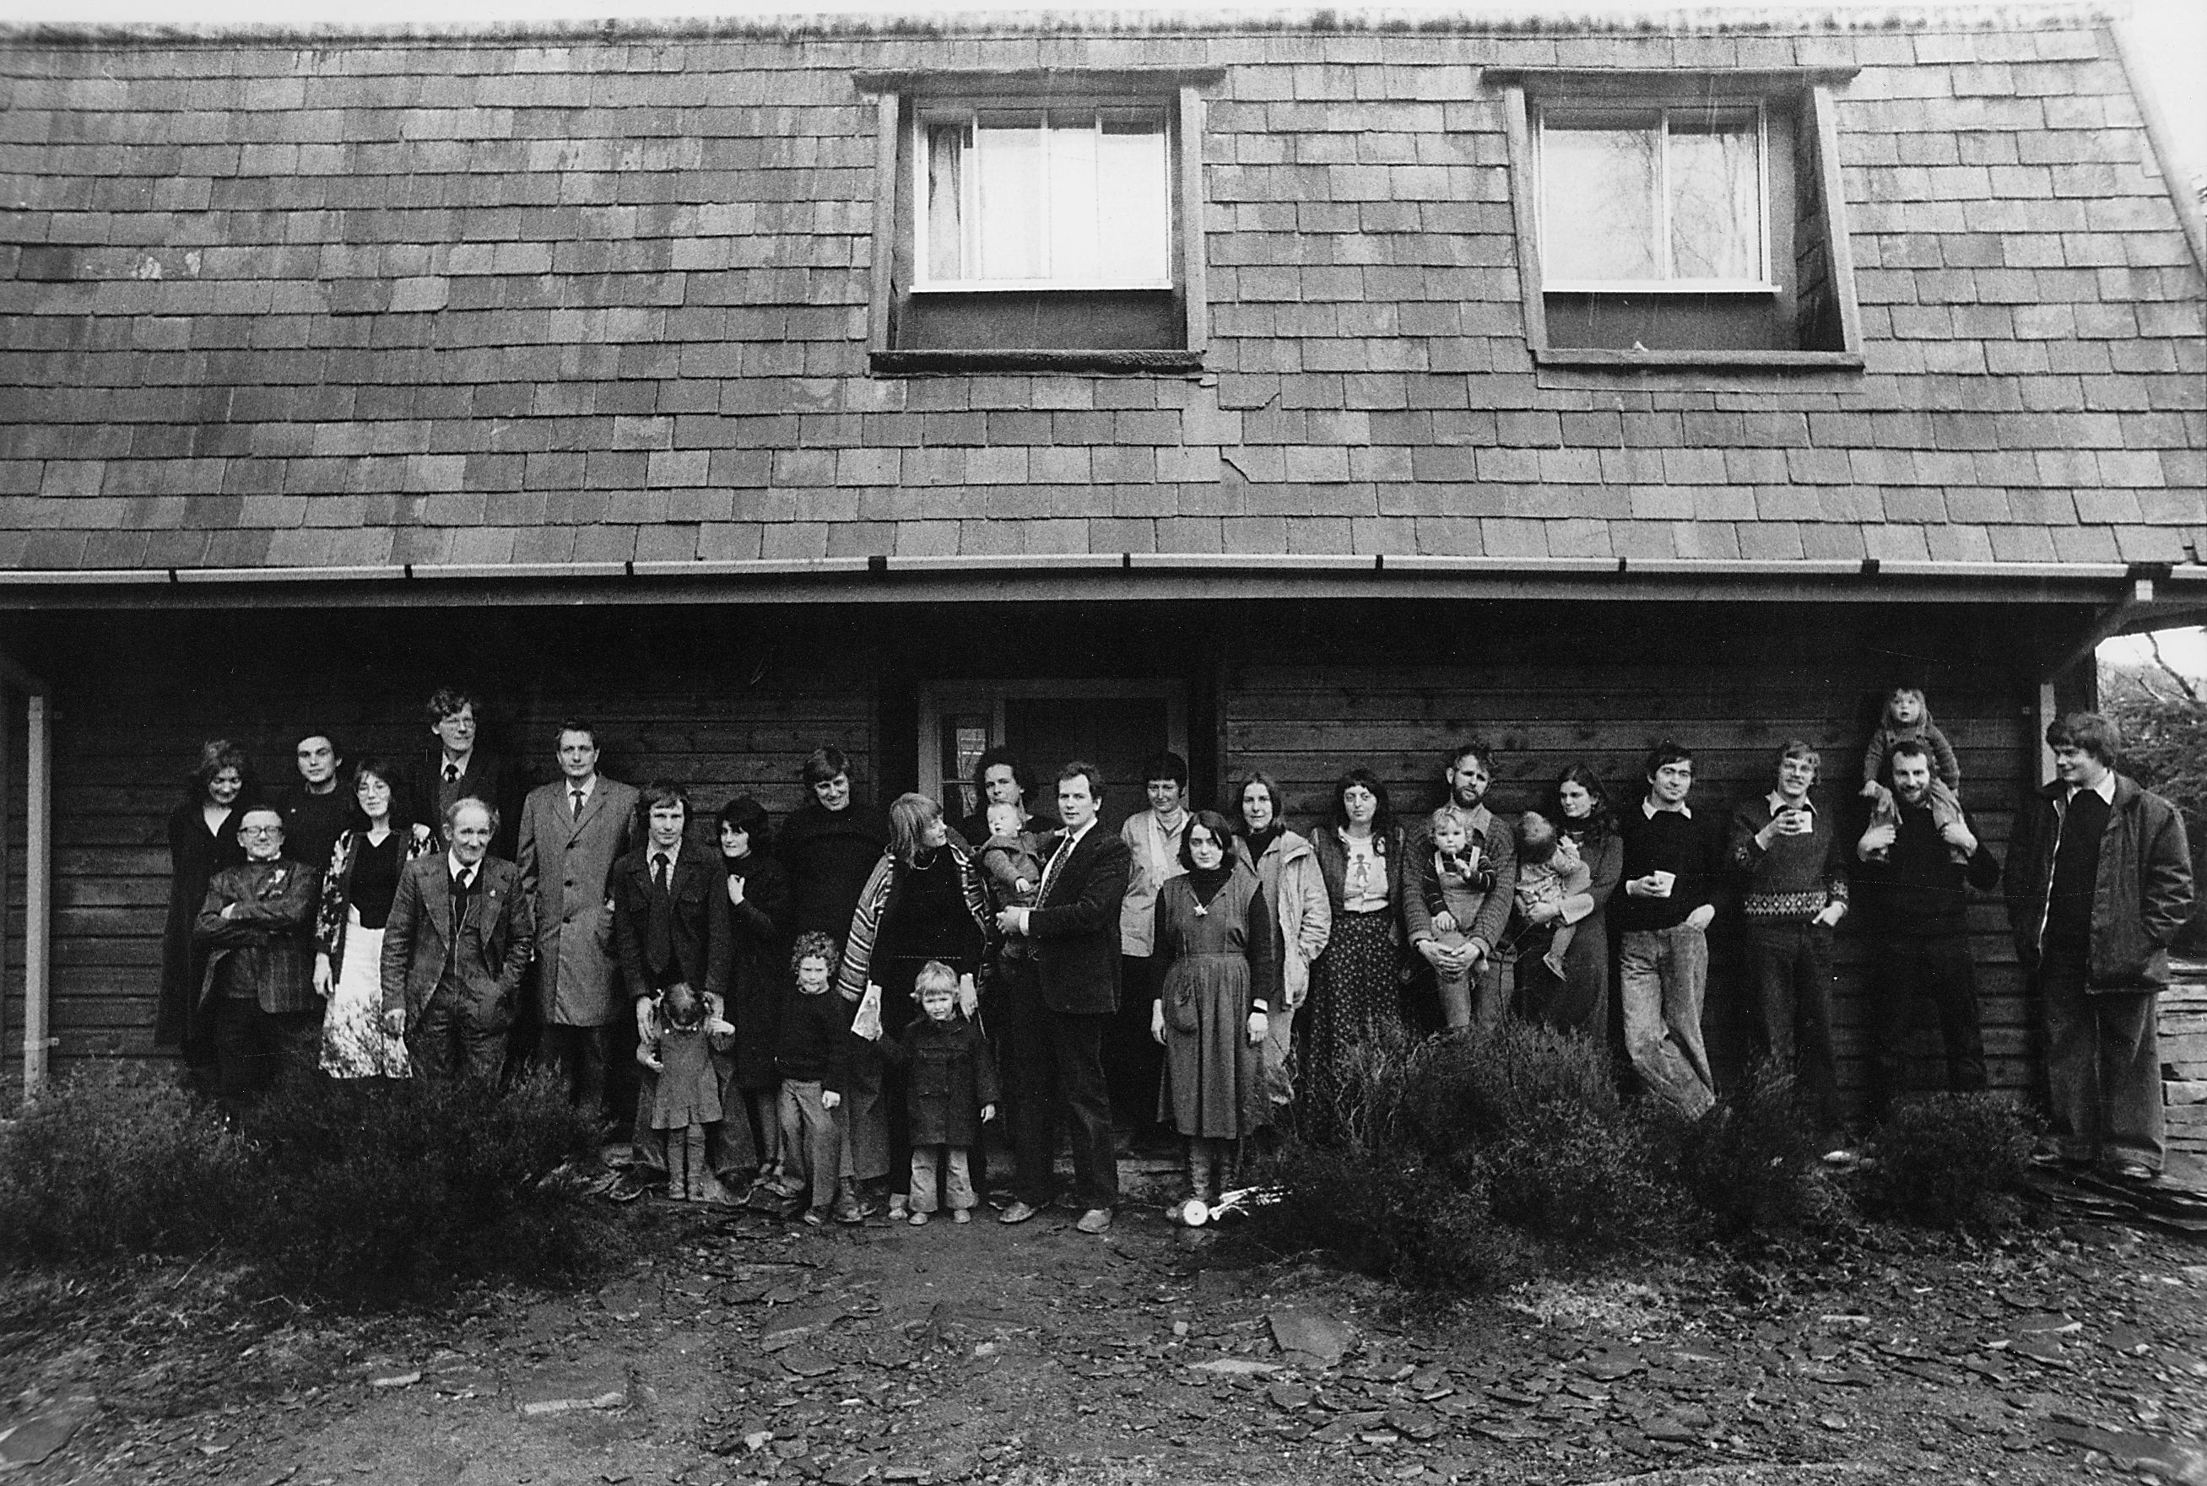
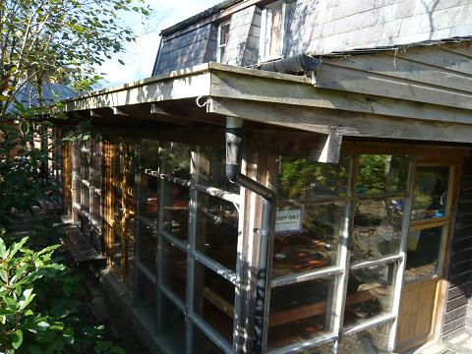
CANADIAN KIT-HOUSE FROM IDEAL HOME EXHIBITION OF 1974

Slide 20
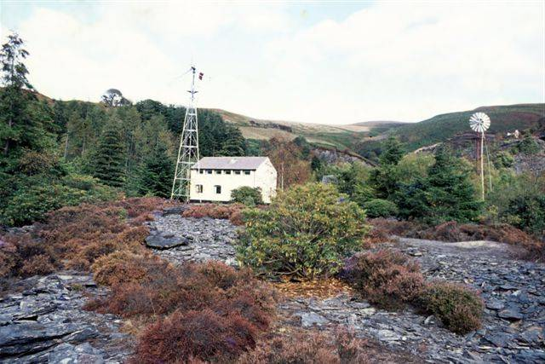
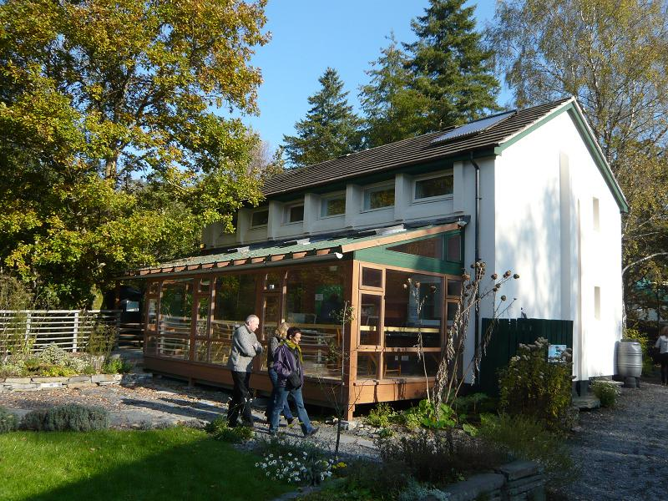
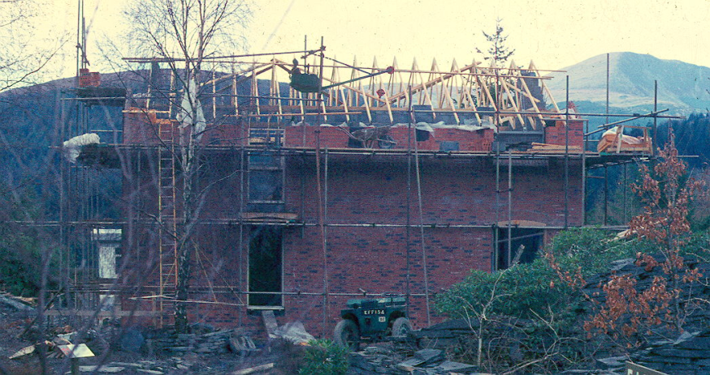
WATES EARLY SUPER-INSULATED HOUSE 1977 THEN THE BEST-INSULATED BILDING IN THE UK, PERHAPS STILL IS

Slide 21
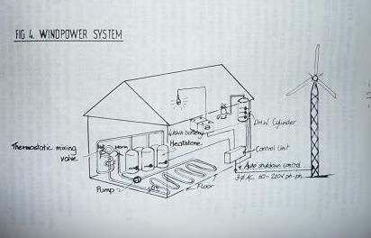

Slide 22
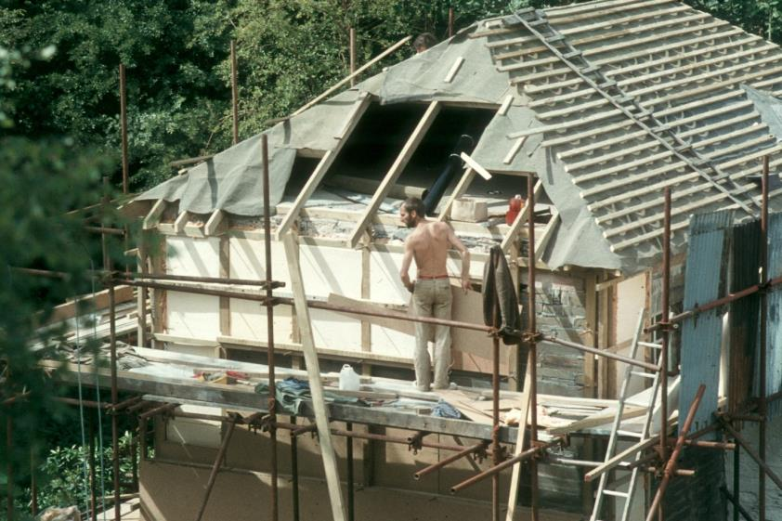
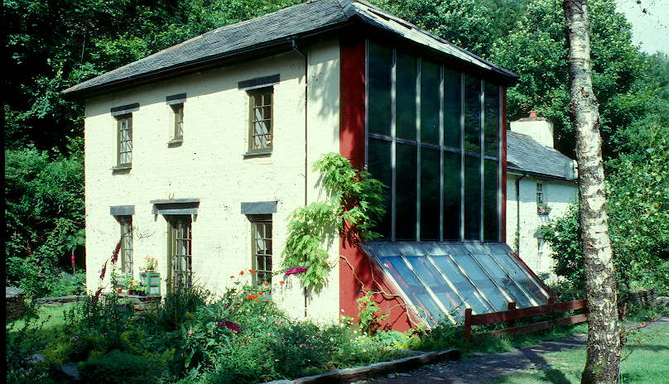

Slide 23
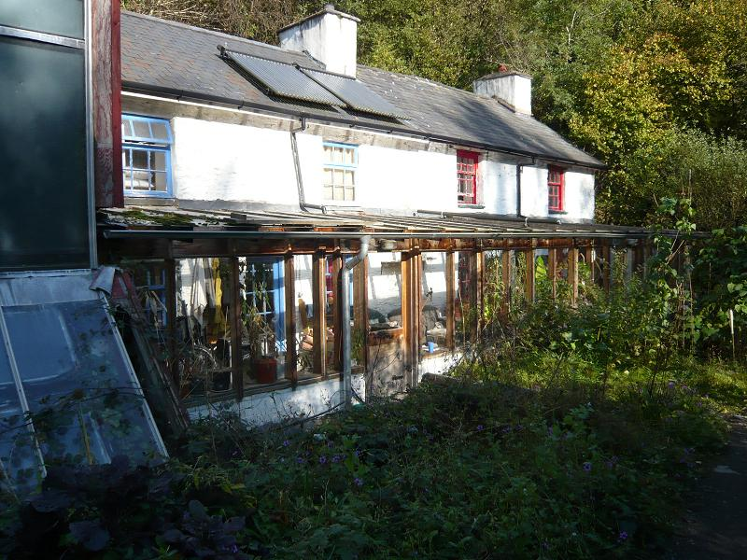

Slide 24
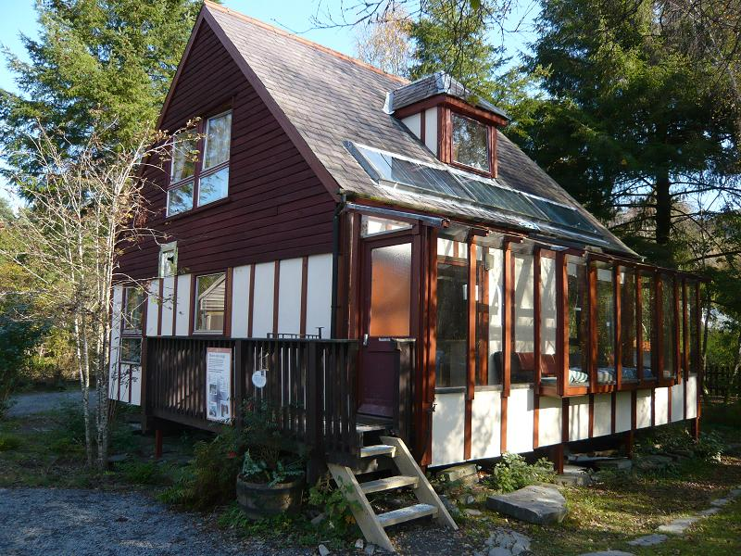
EVOLUTION OF SEGAL SYSTEM AT CAT
Lay-friendly self-build
Low-energy self-build
Eco-friendly materials self-build
Use of hardwoods
Large public buildings

Slide 25
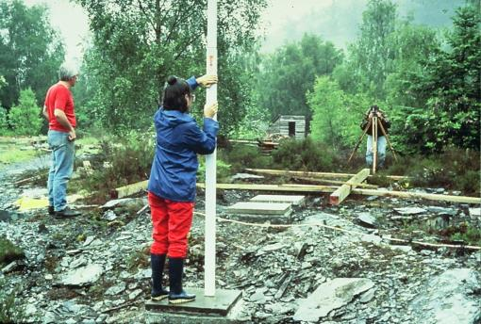
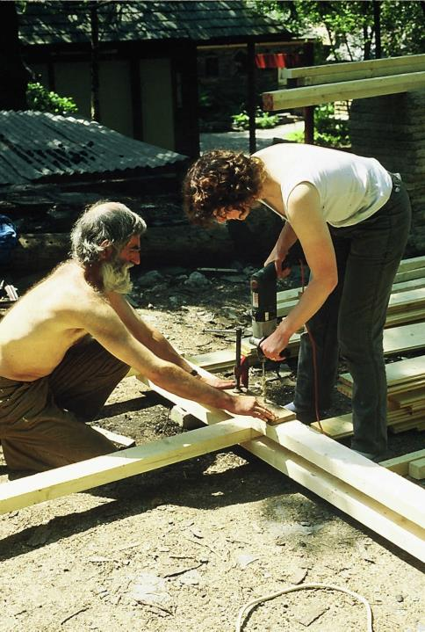
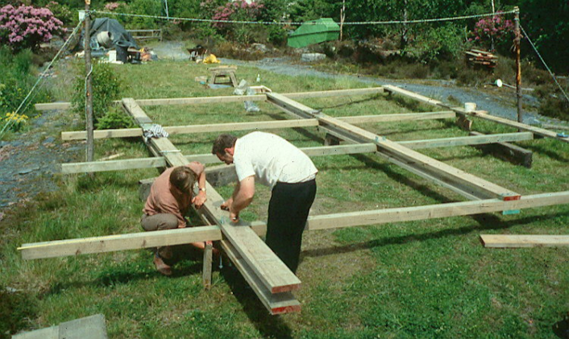

Slide 26
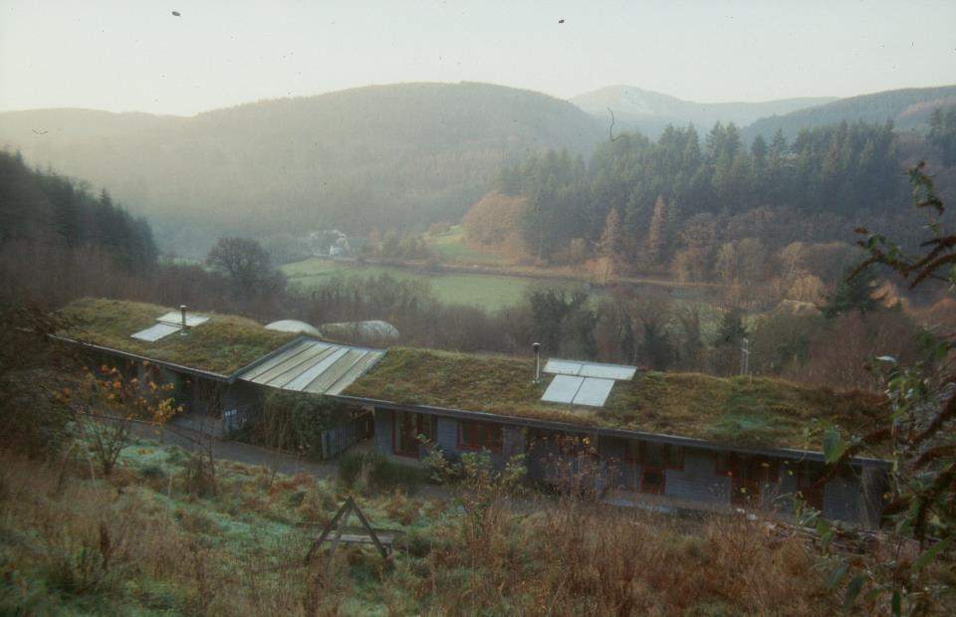

Slide 27
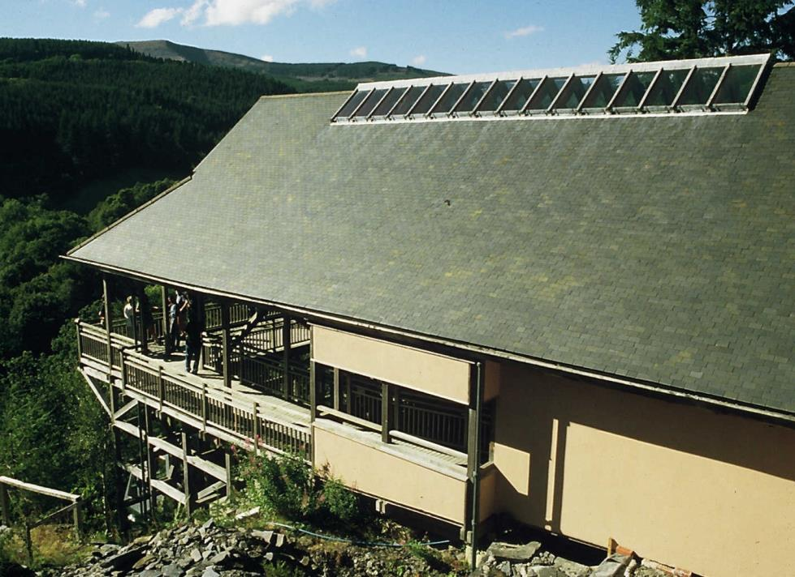
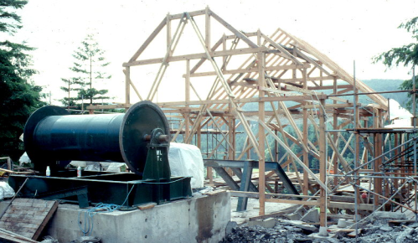
Cliff Railway Stations, CAT Machynlleth
Home-grown oak and recycled pitch-pine frame
Home-grown Larch and Douglas Fir roofing timbers
‘Breathing’ constructions, cellulose insulation

Slide 28
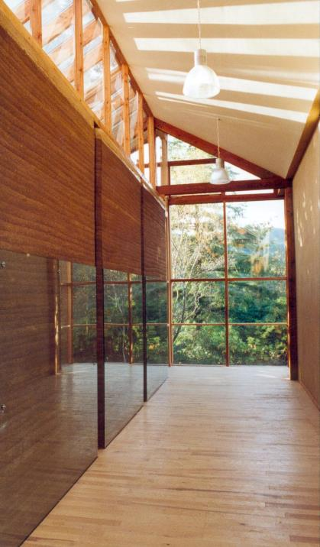
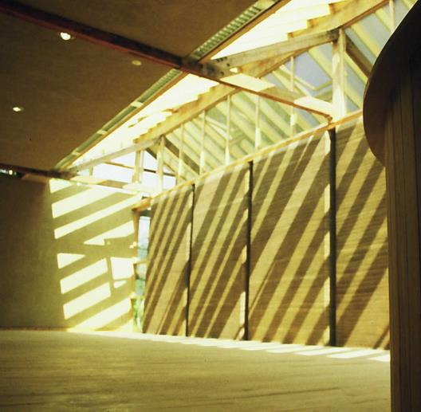
Autonomous Environmental Information Centre Rammed earth walls Home-grown Ash floors over underfloor heating
Notes:
AtEIC Entrance

Slide 29
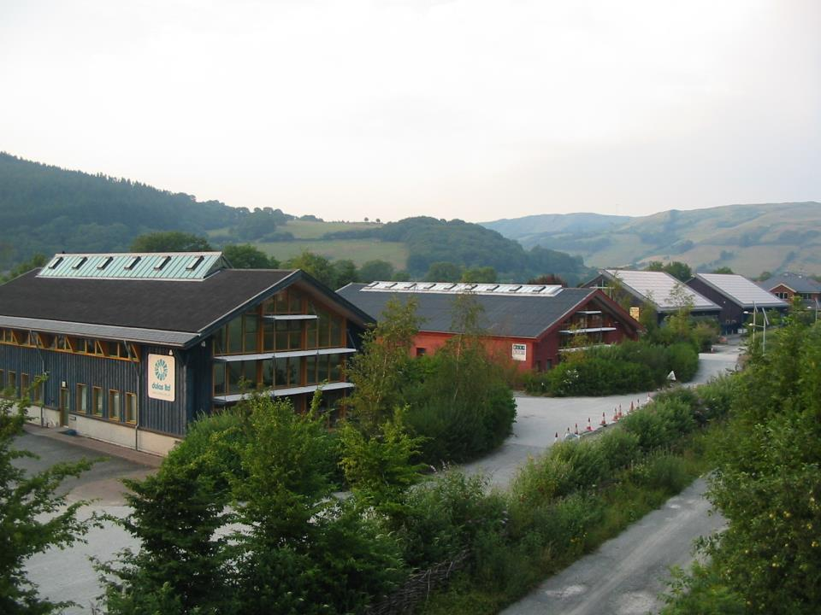
THRE HAS BEEN A HARD-TO-MEASURE BUT DISCERNIBLE INFLUENCE IN THE REGION

Slide 30
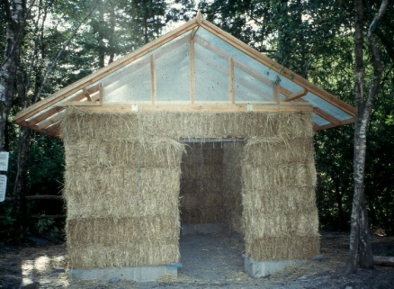
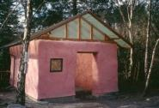
Straw
Reclaimed wood
NATURAL MATERIALS WITH ‘INDUSTRIAL VITAMINS’
Living plants
Wood
Wool
Earth

Slide 31
TRADITIONAL MATERIALS USED AS DECORATION
MODERN MATERIALS USED AS ENABLERS OR ‘INDUSTRIAL VITAMINS’
PRE-INDUSTRIAL
EARLY INDUSTRIAL
MATURE INDUSTRIAL
META- INDUSTRIAL
TRADITIONAL LOW-TECH,
LOW-ENERGY/
LOW-CARBON MATERIALS
HIGH PERFORMANCE, BUT ALSO HIGH IMPACT
LOW-CARBON MATERIALS PROVIDE MOST OF THE BULK, POSSIBLY NET-NEGATIVE-C
HIGH PERFORMANCE
HIGH-CARBON MATERIALS

Slide 32
ESSENTIALLY A NEW PARADIGM IN BUILDING
CAT’s WISE building is an example
Next?
Buildings designed specifically for carbon-sequestration?
Another story…
THE END

